Slide 1

Georgia High School Association
Referee
New Member
Clinic
By Association
Clinicians

Slide 2




Georgia High School Association
Please Turn off ALL electronic devices
EXCEPT
if being used for note-taking

Slide 3
Basic Principles
  SAFETY
  PARTICIPATION
  LEARNING

Slide 4

GHSA
DUAL SYSTEM
OF CONTROL

Slide 5
Responsibilities of Officials
Enforce Laws of the Game
Equal Authority
Pre-game Duties
Start Clock
Make the Call I - IV
Application of Advantage
General Patterns I - V

Slide 6

Enforce Laws of the Game......
.........Decide disputed points
Caution
Disqualify

Slide 7
Equal Authority
Both officials shall have EQUAL AUTHORITY and
responsibilities in the calling of fouls and violations on any part of the field at any time.

Slide 8

Pre-game Duties
Check List
Pre-game Conference
Field Markings and Nets
Instructor scorers, Timers, and Assistant Referees
Equipment of players
Goalkeepers’ Jerseys
Captains’ Numbers

Slide 9
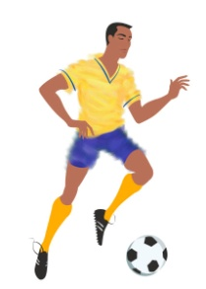
Pre-game For Clock Operator
Start Clock
Legally kicked
Ball leaves hands
and legal enters the field of play
Ball hits ground
Notes:
When the ball legal is in play after a substitution

Slide 10
Making the Call I
Referee blows whistle to STOP play
Sometimes referee blows whistle to START play

Slide 11

Making the Call II
Referee who sees violation, whistles!
Sometimes referee blows the whistle to START play

Slide 12
NFHS RESTART PROCEDURES
SITUATION | NFHS OFFICIAL
START OF EACH HALF | TRAIL
KICKOFF AFTER A GOAL | TRAIL
DROP BALL | TRAIL
GOAL KICK | TRAIL
CORNER KICK | LEAD
PENALTY KICK | LEAD
FREE KICK | LEAD
THROW-IN | OFFICIAL RESPONSIBLE
The recommendation is having the lead official restart play, but always make eye-contact with the other official before restarting play!

Slide 13
Making the Call IV
T
Trail Referee
A
1. Moves even with ball
Placement
2. Covers Encroachments
Delays
A
D
G
A
D
D
Lead Referee
L
1. Moves ahead for play

Slide 14
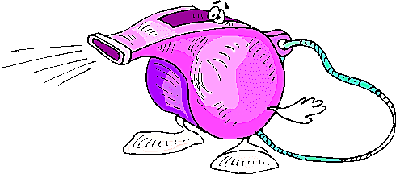
Application of Advantage
Play
On!

Slide 15
General Patterns I
L
T
a. Lead left
b. Lead right
T
L

Slide 16
General Patterns II
25 yds
L
A
D
D
D
G
A
A
D
A
T
Out of bounds responsibilities
Adjust to flow

Slide 17
General Patterns III
L
A
T
A
D
D
G
A
G
A
D
D
D
A
T
A
A
L
Flexible Pattern

Slide 18
Making the Call IV
L
G
D
G
A
A
D
D
A
L
D
D
A
D
A
A
A
T
T
Ball in deep
Lead off to corner
Lead out of way
Near goal line

Slide 19
General Patterns V
L
T
Work opposite – 2nd half

Slide 20
Set Positions
Start of Play
During Play
Free Kick
Corner Kick
Goalkeeper Clearance
Goal Kicks
Penalty Kick
Throw in
Drop Ball

Slide 21
Start of Play
T
A
D
A
D
A
D
L
During pre-game, decide who blows whistle for start of game and restarts
NFHS Rule Book states the Trail would start play with a whistle

Slide 22
G
G
L
D
D
D
L
D
A
A
D
A
A
D
D
A
D
A
T
A
T
A
During Play
Free Kick

Slide 23
L
G
T
G
T
T
D
A
D
A
L
D
Corner Kick
Goalkeeper Clearance

Slide 24
G
L
G
D
D
A
D
T
A
A
D
D
T
A
D
D
A
A
L
D
Goal Kick
Penalty Kick

Slide 25
Throw In
G
G
L
D
A
D
L
D
D
A
D
A
A
D
T
D
A
A
A
D
T
Trail moves toward line
Lead anticipates play

Slide 26
L
D
A
T
Drop
Ball

Slide 27
N.F. Dual System of Control
ADVANTAGES
MORE COVERAGE WITH WHISTLE
BOTH HAVE EQUAL AUTHORITY
  - NO NEED TO LOOK (BE CAREFUL)
SEE FIELD FROM DIFFERENT ANGLES
EACH OFFICIAL CALLS WHAT HE SEES
  AWAY OFFICIAL SHOULD HESITATE
OFFSIDE JUDGE HAS WHISTLE
OFF BALL COVERAGE BETTER
PLAY KEPT BETWEEN TWO OFFICIALS

Slide 28
N.F. Dual System of Control
HELPFUL HINTS
WORK AS A TEAM !!EYE CONTACT!!
RESPECT EACH OTHER'S ABILITY
  DON'T DISPLAY LACK OF CONFIDENCE
MAKE CALLS WHEN YOU SEE THEM
  MAKE SURE YOU ARE IN GOOD POSITION
COVER EACH OTHER
KEEP MOVING....DON'T BE SCREENED OUT
LEAD STAYS AHEAD OF PLAY AND OUT OF FLOW

Slide 29
N.F. Dual System of Control
HELPFUL HINTS
LEAD CALLS OFFSIDE
TRAIL MAY PINCH IN OFF TOUCH LINE
  KEEP PLAY BOXED IN
FUNCTION AS A TEAM
  LOOK AT EACH OTHER
CHANGE TOUCH LINES AT HALFTIME
AT END OF HALF, MEET AT CENTER THEN LEAVE

Slide 30
N.F. Dual System of Control
HELPFUL HINTS
TWO WHISTLES…TOGETHER
IGNORE EACH OTHER
CONFERENCE TOGETHER
EYE COMMUNICATIONS
  WITH HAND SIGNALS
  MORE SERIOUS
CLOSEST REFEREE

Slide 31
N.F. Dual System of Control
SUMMARY
INTENSITY - - BE INVOLVED!!
SILENT SIGNALS
KNOW WHERE THE OTHER REFEREE IS
PERIPHERAL VISION

Slide 32
!!!! Break !!!!
10
Minute
Break

Slide 33


FEDERATION DIFFERENCES
vs.

Slide 34
FEDERATION DIFFERENCES
RULE 1 - THE FIELD OF PLAY
  FIELD LENGTH 100/120 RECOMMENDED 110
  FIELD WIDTH 55/80 RECOMMENDED 65
  LINE WIDTH 4" (DISTINCTIVE COLOR)
  (NON-CAUSTIC MATERIALS)
  2’ PENALTY LINE OR 9” SPOT
  GOAL POSTS MAY BE PADDED – 1” THICK X 72” HEIGHT
  NETS SHALL BE ATTACHED

Slide 35
FEDERATION DIFFERENCES
RULE 1 - THE FIELD OF PLAY
  OFFICIAL AND TEAM AREAS
SAME SIDE (RECOMMENDED DURING SEASON & MANDATED FOR ALL PLAY-OFFS)
    OFFICIAL - 5 YARDS FROM HALF LINE
    TEAM - 10-30 YARDS FROM HALF LINE
    10 FEET FROM TOUCHLINE
OPPOSITE SIDE
    TEAM - 10 YARDS FROM THE HALF LINE
    10 FEET FROM TOUCHLINE
    BENCHES WILL BE ON A DIAGONAL FROM EACH OTHER
  SPECTATORS
    10 FEET FROM TOUCH LINE AND TEAM/OFFICIAL AREA
    NOT PERMITTED DIRECTLY BEHIND GOAL UNLESS IN BLEACHERS

Slide 36
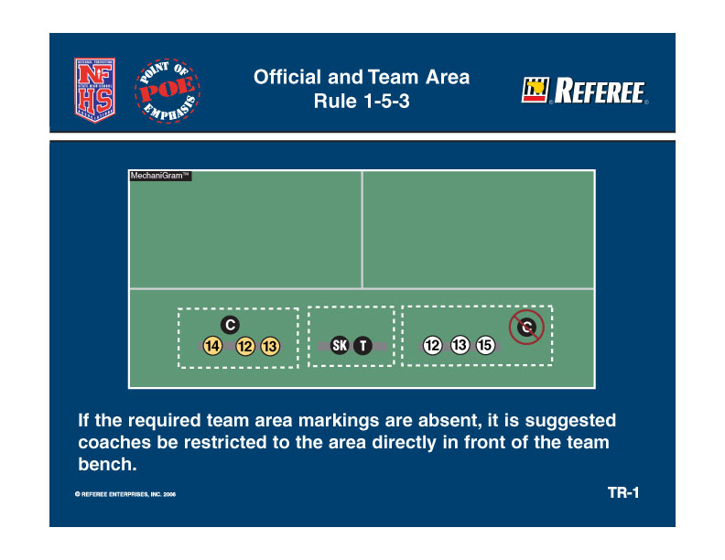
FEDERATION DIFFERENCES
RULE 1 - THE FIELD OF PLAY

Slide 37
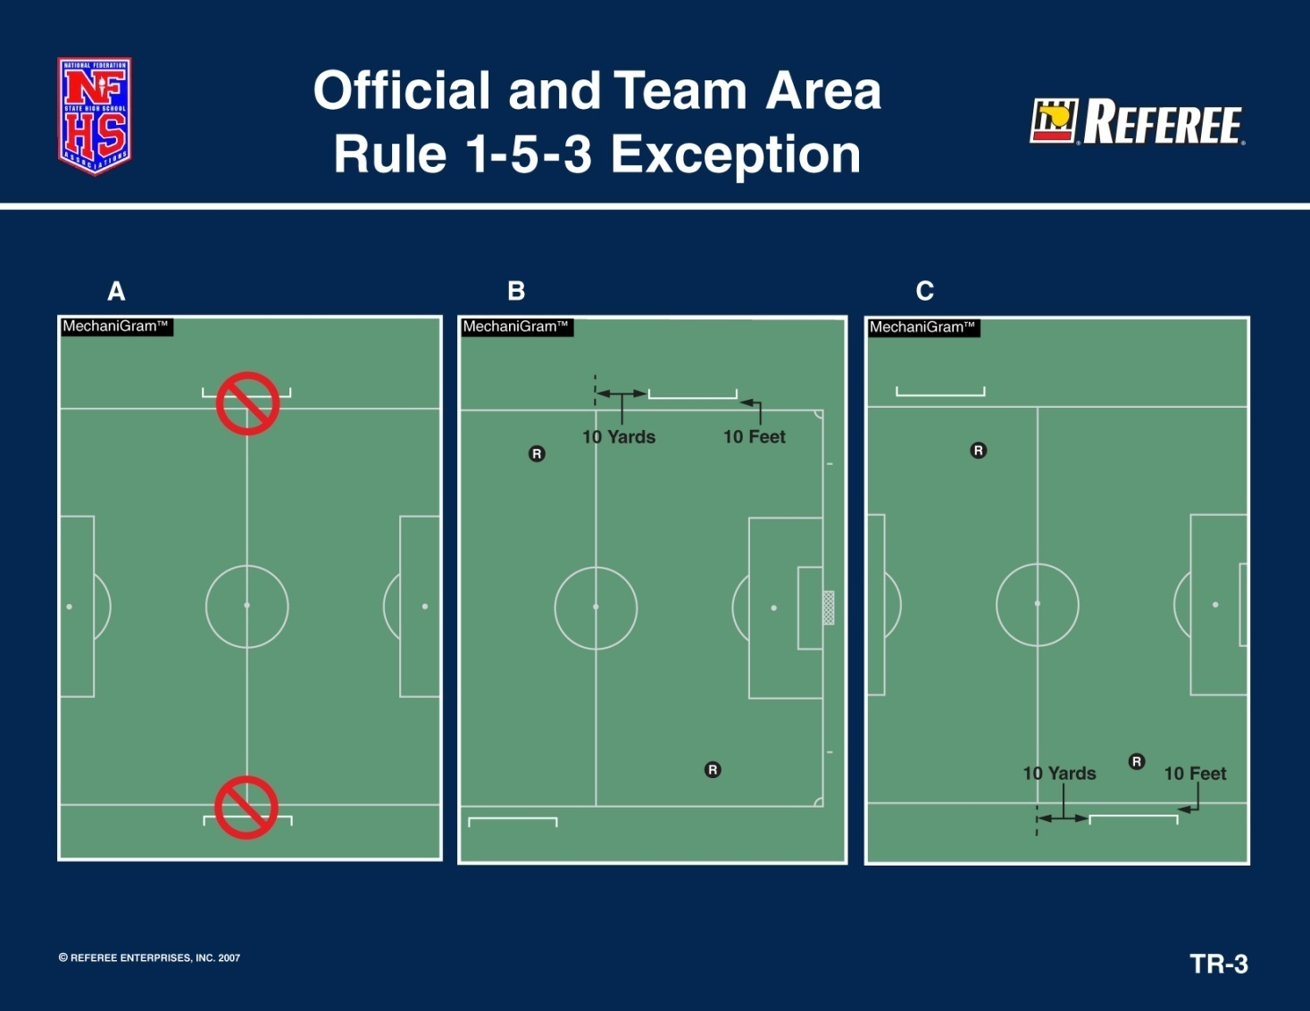
FEDERATION DIFFERENCES
RULE 1 - THE FIELD OF PLAY

Slide 38
FEDERATION DIFFERENCES
RULE 2 - THE BALL
  THE BALL
    HOME TEAM RESPONSIBILITY
    3 OR MORE SIMILAR
    NFHS LOGO ON THE BALLS
    (IF NOT, REFEREE CHOOSES)
  IF BALL BECOMES DEFLATED,
    DEAD WHERE LAST PLAYED EXCEPT
    IN THE GOAL AREA
  DROP BALL TO
    PLAYER OF THE TEAM LAST IN POSSESSION
  AT LEAST TWO BALL HOLDERS
Notes:
The big difference is in FIFA it is where the ball becomes deflated and HS where last played. The drop ball is now the same

Slide 39
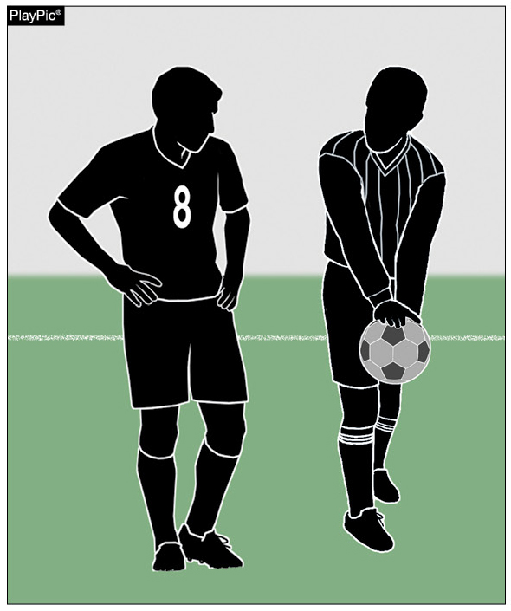
Rule 2-2-4
Deflated Ball
FEDERATION DIFFERENCES
If the ball becomes deflated during play, it will be put into play with a drop ball to a player of the team last in possession at the spot where it was last played.
Notes:
RULE 2-2-4 DEFLATED BALL
If the ball becomes deflated during play, it will be put into play with a drop ball to a player of the team last in possession at the spot where it was last played EXCEPT IN THEIR OWN GOAL AREA.

Slide 40
FEDERATION DIFFERENCES
RULE 3 - THE PLAYER & SUBSTITUTIONS
EACH TEAM SHALL HAVE A CAPTAIN AND HE MAY ADDRESS THE OFFICIALS
TEAM ROSTER PRESENTED BY COACH OR PLAYER
  5 MINUTES PRIOR TO START THE GAME
  NAMES MAY BE ADDED AFTER THE START OF PLAY
IF TEAM CONSUMES TIME FOR SUB IN LAST 5-MINUTES…
IF REPORTED AND WANTS TO SUB, ONCE BECKONED SHALL ENTER UNLESS:
  END OF PERIOD
  GOAL SCORED
A SUBSTITUTE BECOMES A PLAYER WHEN HE/SHE IS BECKONED ONTO THE FIELD OF PLAY
THE DEPARTING PLAYER DOES NOT HAVE TO BE OFF THE FIELD TO BECKON ON THE SUBSTITUTE
Notes:
The clock shall be stopped when a substitute by the team in the lead is beckoned onto the field in the final five minutes of the second period and in the second period of the overtime.

Slide 41
FEDERATION DIFFERENCES
RULE 3 - THE PLAYER & SUBSTITUTIONS
SUBSTITUTES - EITHER TEAM OFF THE BENCH
  BETWEEN PERIODS
  AFTER GOAL (MUST WAIT TO BE BECKONED BY REFEREE)
  INJURED PLAYER ATTENDED ON THE FIELD (ATTENDED PLAYER MUST LEAVE THE FIELD) AND MAY BE SUBSTITUTED (MUST WAIT TO BE BECKONED BY REFEREE)
SUBSTITUTES - EITHER TEAM, IF PRIOR REPORTED
  CAUTION (CAUTIONED PLAYER MUST LEAVE AND MAY BE SUBSTITUTED FROM OFF THE BENCH)
  DISQUALIFIED (STILL PLAY SHORT)
  GOAL KICK
SUBSTITUTES - TEAM POSSESSION , IF PRIOR REPORTED
  THROW IN (OPPONENT, IF TEAM IN POSSESSION SUBSTITUTES)
  CORNER KICK (OPPONENT, IF TEAM IN POSSESSION SUBSTITUTES)
MUST REPORT PRIOR TO DEAD BALL (NEAREST OFFICIALAT HALF LINE IF NO SCORER TABLE)
INJURED PLAYER APPEARS UNCONSCIOUS...

Slide 42
FEDERATION DIFFERENCES
RULE 3 - THE PLAYER & SUBSTITUTIONS
Prior to entering the game after a goal is scored or when a player is injured and removed, players are required to check in with the scorer/timer – or referee if there is no scorer/timer. After checking in, the player must wait until he or she is beckoned onto the field by the referee.

Slide 43
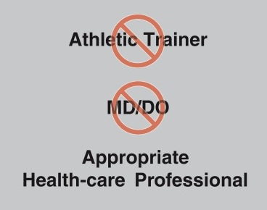
FEDERATION DIFFERENCES
RULE 3 - THE PLAYER & SUBSTITUTIONS
Rule 3-3-1c1, 4-2-8
Wording of “athletic trainer” and “MD/DO” are changed to “appropriate health-care professional” to allow each association to follow state law.

Slide 44
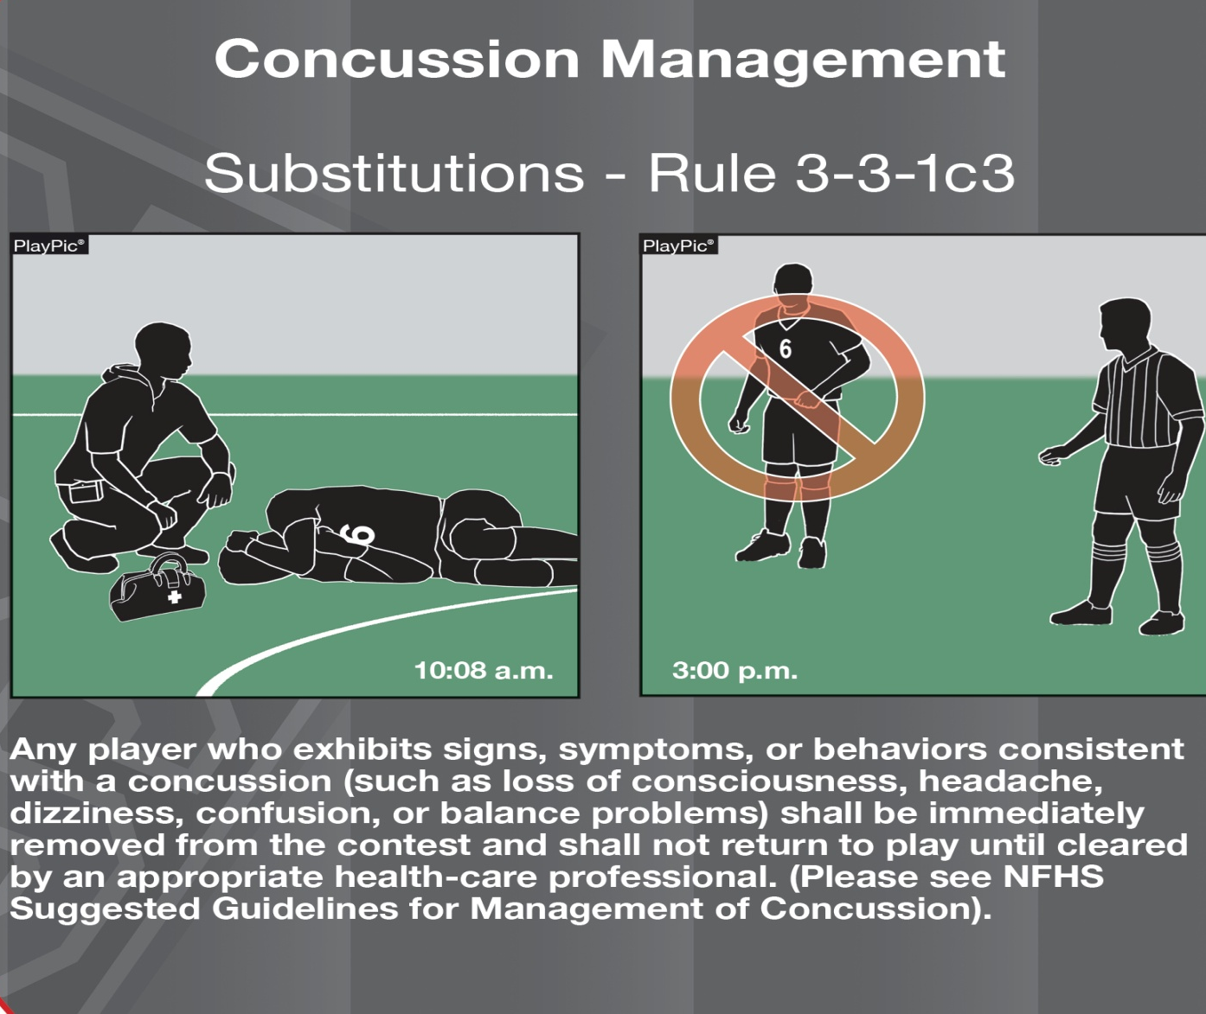
FEDERATION DIFFERENCES
RULE 3 - THE PLAYER & SUBSTITUTIONS
Notes:
Note the time difference on each slide

Slide 45
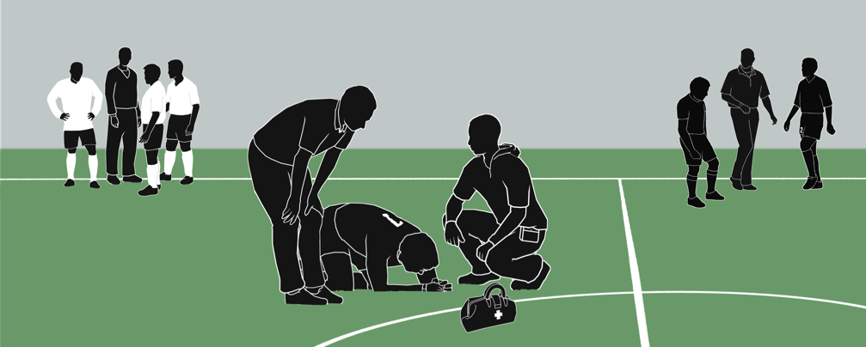
Substitutions
Rule 3-3-2b(1)
PlayPic®
Limitations on coaching during injury situations were removed. Whether a short injury stoppage or a prolonged stoppage, coaches from both teams may coach — give tactical and technical instructions, lend emotional support, etc.
Notes:
Limitations on coaching during injury situations were removed. Whether a short injury stoppage or a prolonged stoppage, coaches from both teams may coach — give tactical and technical instructions, lend emotional support, etc.

Slide 46
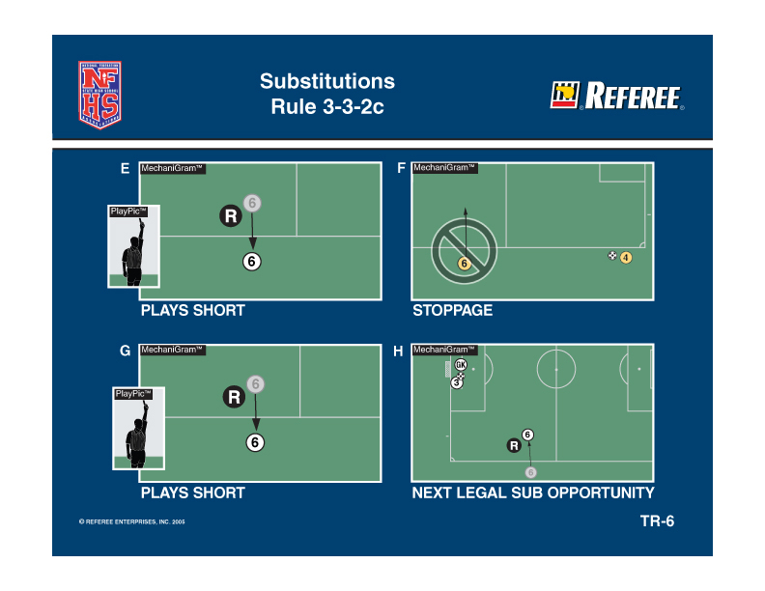
FEDERATION DIFFERENCES
RULE 3 - THE PLAYER & SUBSTITUTIONS
Notes:
Cautioned player

Slide 47
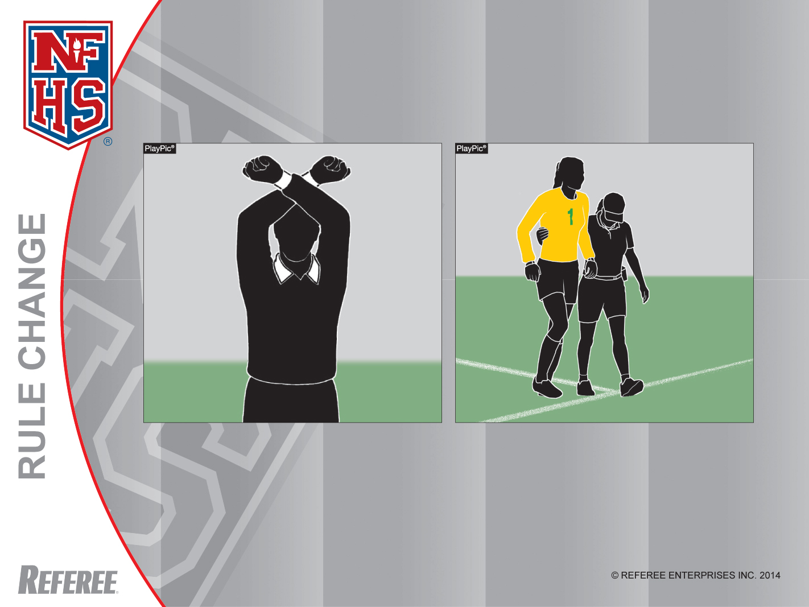
Substitutions
Rule 3-3-2b(2)
If the referee stops the clock for an apparent injury to a field player or goalkeeper, the field player or goalkeeper will have to leave the field. The field player may be replaced, and the goalkeeper must be replaced.
Notes:
ART. 2 . . . Time for Substitutions: either team may substitute an unlimited number of players from the bench, provided they report to the scorer's table or nearest official and are beckoned in as per 3-4-1(a):
a. when a goal is scored.
b. when a player is injured:
1. A coach or appropriate health-care professional may not enter the field without approval from a referee.
2. If the referee stops the clock for an apparent injury to a field player or goalkeeper, the field player or goalkeeper will have to leave the field. The field player may be replaced, and the goalkeeper shall be replaced.
COMMENTS ON THE RULES
Risk minimization is one of the major tenets of NFHS sports and the rules-writing process. The committee wanted to make sure that players who were apparently injured were evaluated by a coach or an appropriate health-care professional. The overriding concern is the safety of all players. Previously, the goalkeeper was not required to leave the game when the referee stopped the clock.
This new rule requires the field player and goalkeeper to receive equal protection.

Slide 48
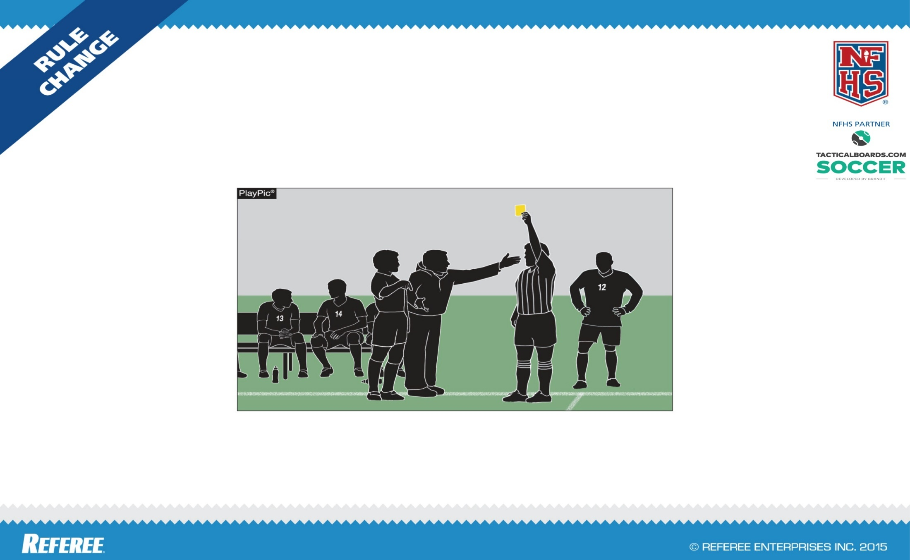
FEDERATION DIFFERENCES
SUBSTITUTION ON BENCH PERSONNEL MISCONDUCT
RULE 3-3-3(e) (new)
If the game is stopped to issue a caution to or to disqualify bench personnel, any player who has already reported to be a substitute can enter the game.

Slide 49
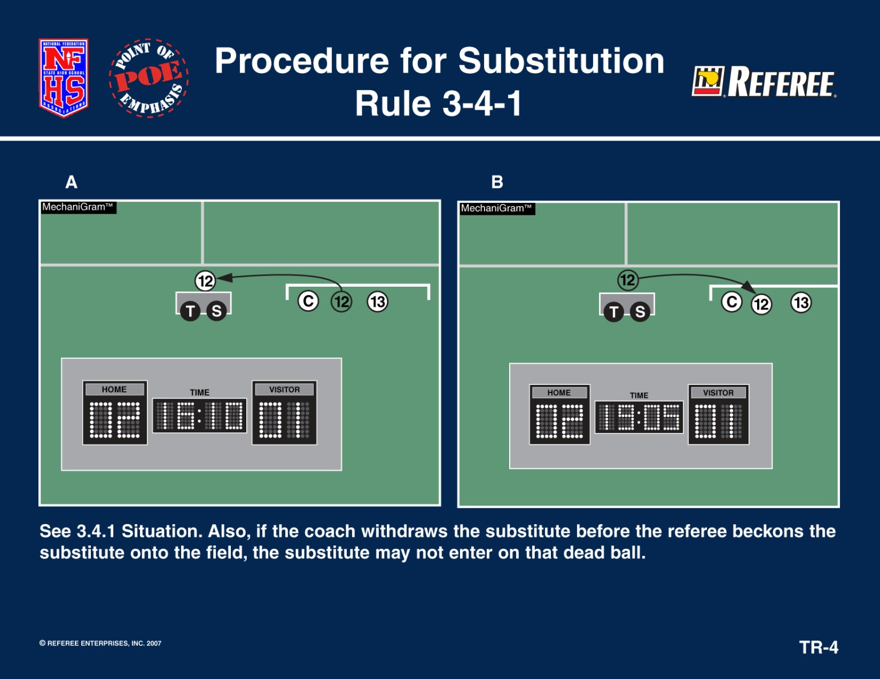
FEDERATION DIFFERENCES
RULE 3 - THE PLAYER & SUBSTITUTIONS

Slide 50
FEDERATION DIFFERENCES
RULE 3 - THE PLAYER & SUBSTITUTIONS
PENALTY KICK – NOT A SUBSTITUTION TIME
  CAUTIONED PLAYER(S)
  INJURED PLAYER(S)
  DISQUALIFIED GOALKEEPER MAY BE SUBSTITUTED FROM THE BENCH, BUT TEAM STILL PLAYS SHORT
  NO SUB MAY TAKE PENALTY KICK
GOALKEEPER/FIELD PLAYER MAY SUBSTITUTE AT NORMAL SUBSTITUTION TIMES OR CLOCK STOPPAGE
IF GOALKEEPER AND PLAYER CHANGE WITHOUT REFEREE’S PERMISSION, IT IS A VERBAL ADMONISHMENT
CAST IF COVERED & FACIAL MASKS WITH A MEDICAL RELEASE ARE ALLOWED
IF A TEAM IS PLAYING SHORT FOR OTHER REASONS THAN MISCONDUCT, THEY MAY ADD ANY LEGAL PLAYER (NOT A SUBSTITUTE) AT ANY STOPPAGE WITH REFEREE’S PERMISSION
Notes:
If a goalkeeper is disqualified on a penalty kick situation, he/she may be substituted from off the bench. New change from NFHS.
During a penalty kick, the substitution situations are only for the cautioned/injured player, not unlimited.

Slide 51
FEDERATION DIFFERENCES
RULE 4 - PLAYER EQUIPMENT
LOGO/TRADE NAME – MAY NOT EXCEED 1 1/2" X 1 1/2" ON EACH ITEM OF APPAREL
AMERICAN FLAG – MAY NOT EXCEED 2” X 3”
SCHOOL LOGOS AND PLAYERS NAMES HAVE NO SIZE RESTRICTED
SOFT & YIELDING CAPS OF THE SAME COLOR ARE LEGAL IN INCLEMENT WEATHER
SHINGUARDS MUST BE NOCSAE APPROVED
  NO PERMANENT LABEL, NO PLAY
  APPROPRIATE HEIGHT RANGE OF PLAYER MUST BE LEGIBLE
  WORN NO HIGHER THAN 2” ABOVE THE ANKLE

Slide 52
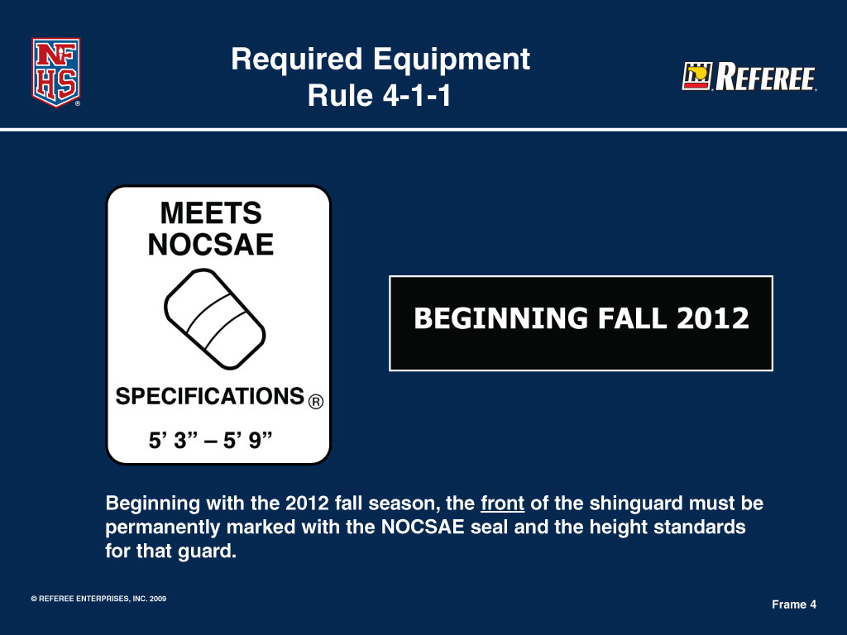
FEDERATION DIFFERENCES
Proper NFHS Shinguards
Notes:
52

Slide 53
FEDERATION DIFFERENCES
Rule 4-1-1A, B
Alters the jersey colors required for teams such that the home team wears dark jerseys and socks, and the visiting team wears solid white jerseys and socks.
Notes:
Rule 4-1-1A, B
Alters the jersey colors required for teams such that the home team wears dark jerseys and socks and the visiting team wears all-white jerseys and socks. NO COLOR REQUIREMENT FOR SHORTS

Slide 54
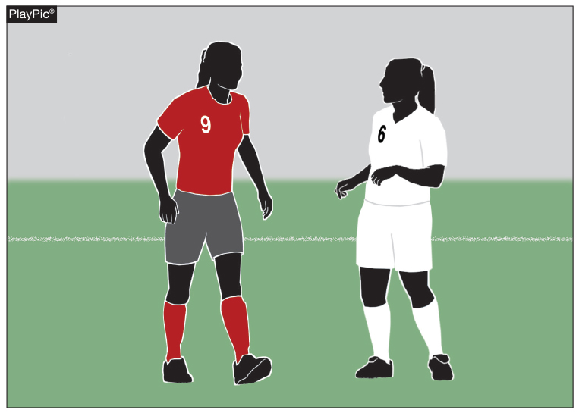
FEDERATION DIFFERENCES
Rule 4-1-1a, b
Required Equipment (Uniform)
Player A is on the Home team and is required to wear the dark colored jersey (clear contrast to white) and dark socks; Player B is a part of the visiting team and is required to wear an all-white jersey and all-white socks.
Notes:
Player A is on the Home team and is required to wear the dark colored jersey (clear contrast to white) and dark socks; Player B is a part of the visiting team and is required to wear an all-white jersey and all-white socks.

Slide 55
FEDERATION DIFFERENCES
RULE 4-1-1D
Allows for visible undergarments to be worn if they are of similar length and of a solid color.
Notes:
Allows for visible undergarments to be worn if they are of similar length and of a solid color.

Slide 56
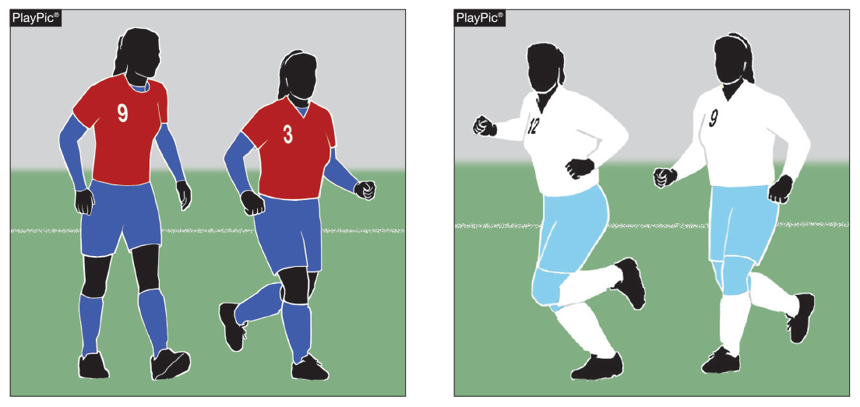
FEDERATION DIFFERENCES
Rule 4-1-1d: Required Equipment (Undergarment)
Any undergarment worn by players must be of a solid like-color for the team members and a similar length for individuals. PlayPic A shows the home team members wearing like-color undergarment. PlayPic B shows the visiting team wearing the all-white jersey and socks with blue shorts and tights.
Notes:
Allows for visible undergarments to be worn if they are of similar length and of a solid color.

Slide 57
FEDERATION DIFFERENCES
RULE 4 - PLAYER EQUIPMENT
REQUIRED EQUIPMENT
  JERSEY DARK = HOME SOLID WHITE = VISITOR
  SHORTS SIMILAR DESIGN & COLOR FOR THE TEAM
  STOCKINGS DARK = HOME SOLID WHITE = VISITOR
  SHOES = SAFE
  NUMBERS 6" REAR OF JERSEY
  4" FRONT OF JERSEY OR PANTS OR SHORTS
ILLEGAL vs. IMPROPER EQUIPMENT - RULE 4 SECTION 2
  CAUTION COACH ON FIRST INCIDENCE OF ILLEGAL EQUIPMENT ON PLAYERS
  CAUTION PLAYER ON ANY INCIDENCES OF ILLEGAL EQUIPMENT FOUND AFTER THE FIRST INCIDENT

Slide 58
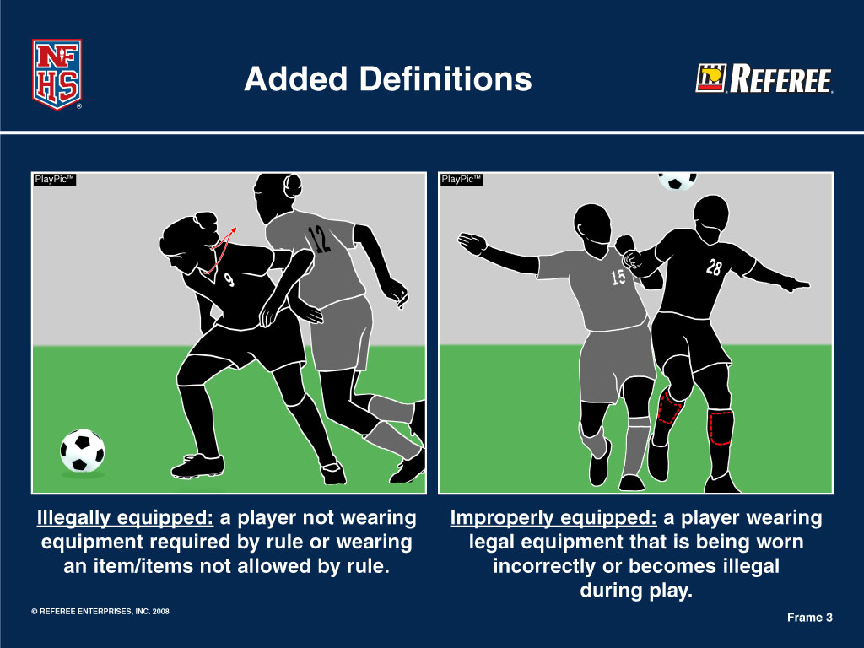
FEDERATION DIFFERENCES
RULE 4 - PLAYER EQUIPMENT (ILLEGAL vs. IMPROPER)

Slide 59
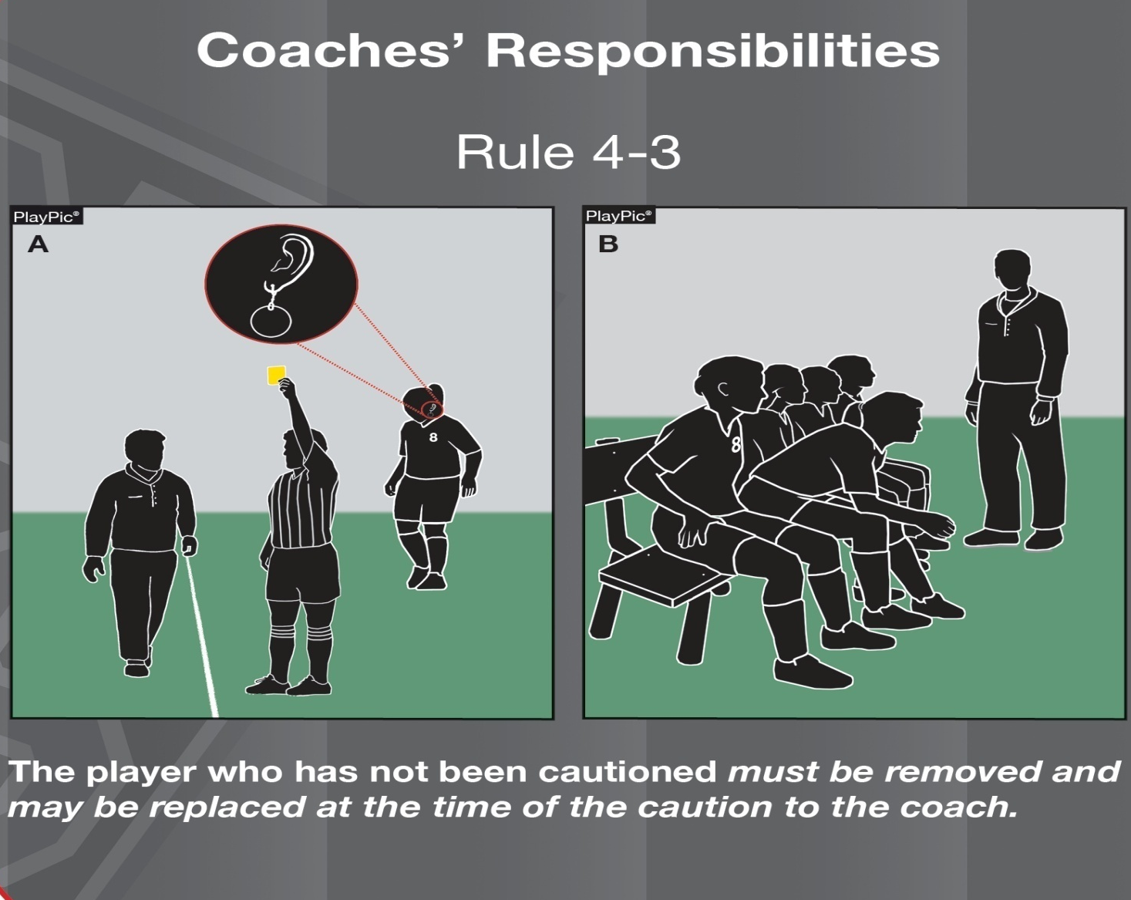
FEDERATION DIFFERENCES
RULE 4 - PLAYER EQUIPMENT

Slide 60
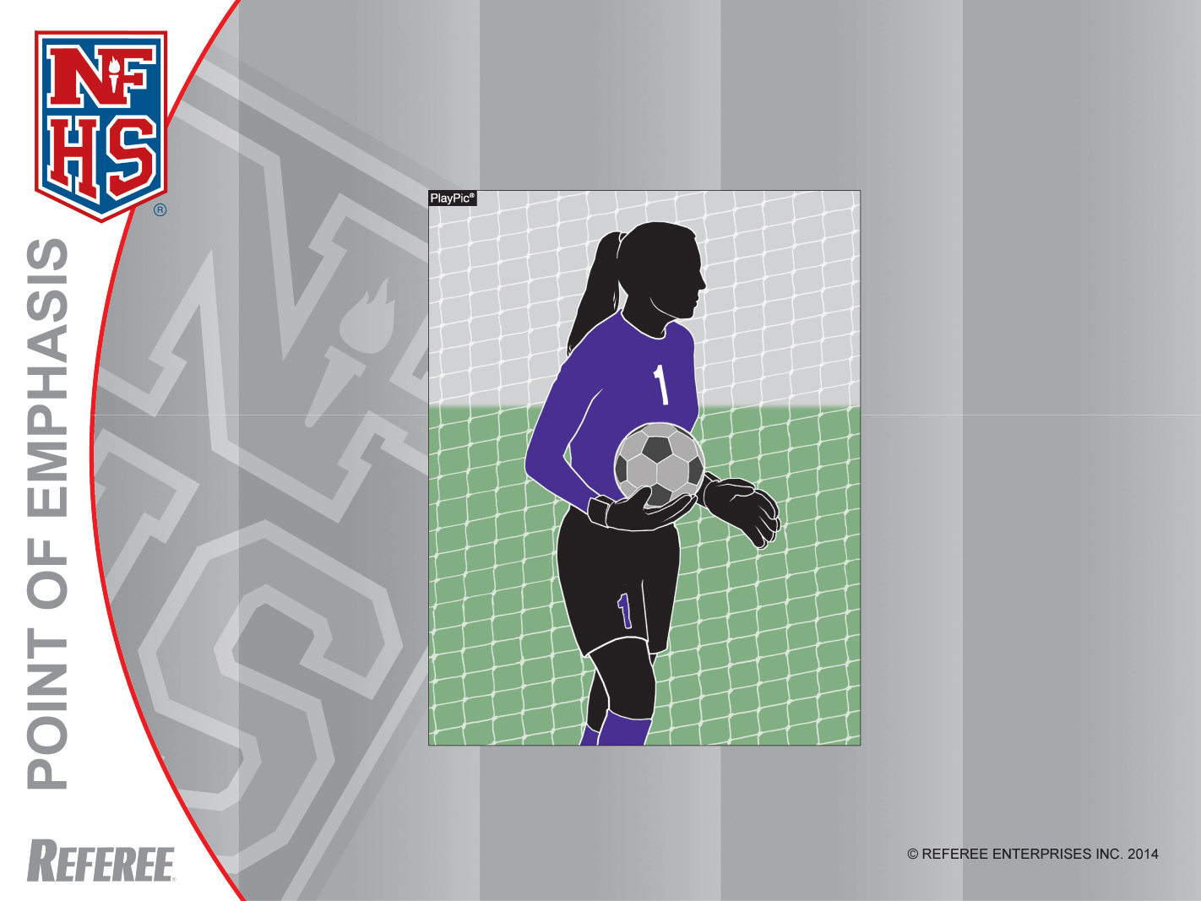
Goalkeepers
Goalkeepers must have a 4” number on the front of their jerseys or shorts/pants and a 6” number on the back of their jerseys.
Notes:
Goalkeepers – Goalkeepers must have a 4” number on the front of their jerseys or shorts/pants and a 6” number on the back of their jerseys.

Slide 61
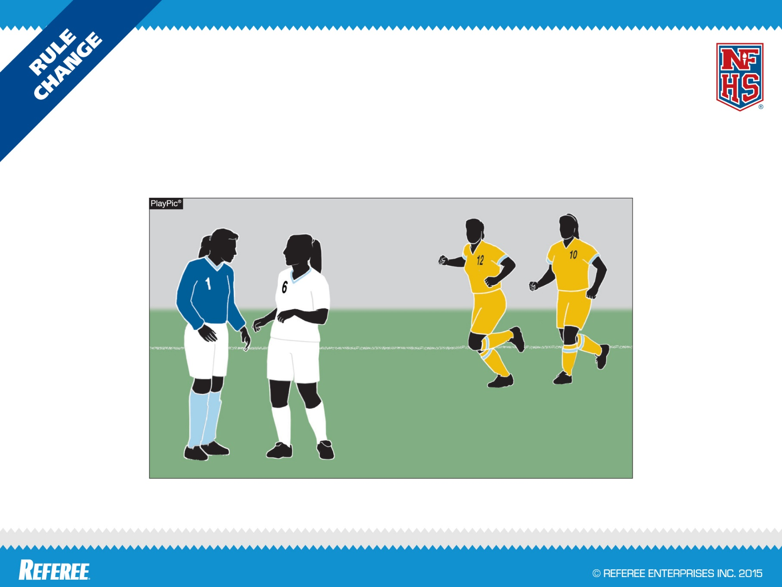
FEDERATION DIFFERENCES
GOALKEEPER SOCKS
DIFFERING FROM OPPONENTS
RULE 4-1-1(h)3
Socks of goalkeeper must differ from opponents.

Slide 62
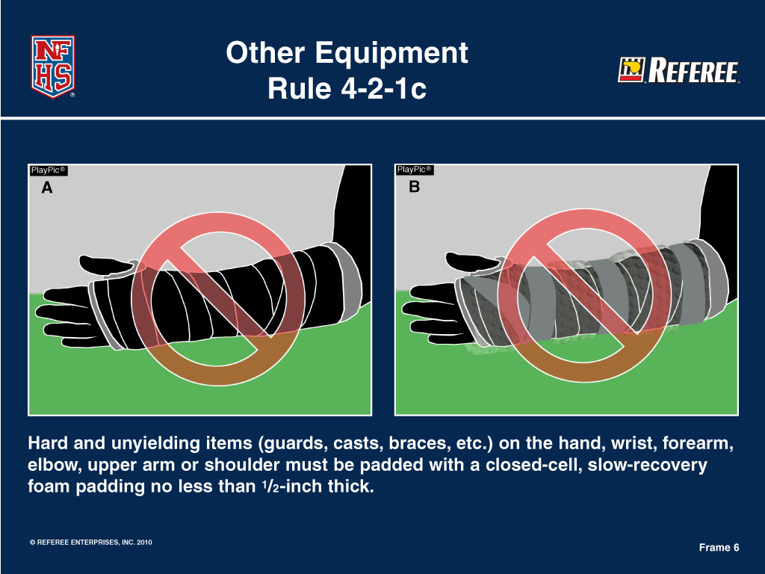
FEDERATION DIFFERENCES
RULE 4 - PLAYER EQUIPMENT
Notes:
The player does not require a medical release

Slide 63
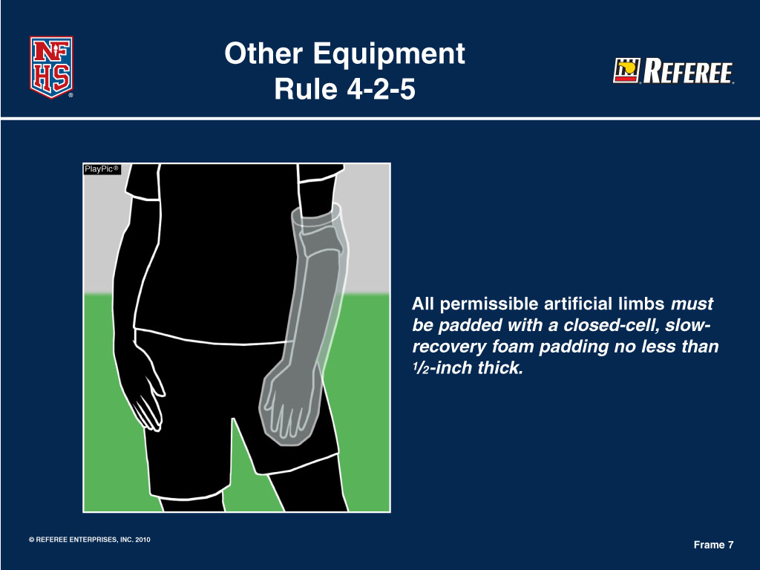
FEDERATION DIFFERENCES
RULE 4 - PLAYER EQUIPMENT
Notes:
The player does not require a medical release

Slide 64
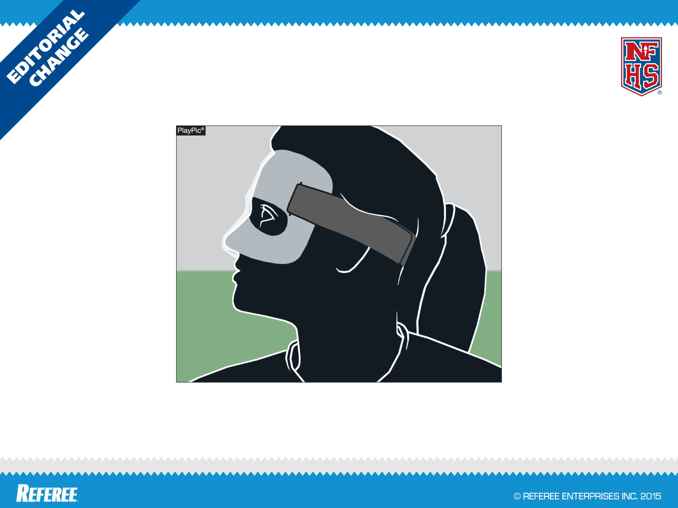
FEDERATION DIFFERENCES
PROTECTIVE FACE MASK
RULE 4-2-8
Removing “with no protrusion” from the rule clears the issue of the nose as a protrusion.
Notes:
This does require a medical release

Slide 65
FEDERATION DIFFERENCES
RULE 4-2-9
A soft padded headgear
A soft padded headgear that meets the ASTM standard is permitted.
No headgear can stop athletes form suffering concussions, and all sports should be played, coached and officiated in recognition of that fact.
Notes:
RULE 4-2-9 A SOFT PADDED HEADGEAR
A soft padded headgear that meets the ASTM standard is permitted.
No headgear can stop athletes form suffering concussions, and all sports should be played, coached and officiated in recognition of that fact.
This rule change allows for the use of the newer headgear styles that are currently on the market to be used that are not just headbands.

Slide 66
FEDERATION DIFFERENCES
Rule 4-2-9
Other Equipment
The ability to wear headgear has been expanded beyond headbands. PlayPic A remains legal and the change now makes PlayPic B legal. Wearing of any headgear is not required. Schools, parents and students are encouraged to make their own assessment on the type of equipment worn via ASTM standards.
Notes:
RULE 4-2-9 – OTHER EQUIPMENT
The ability to wear headgear has been expanded beyond headbands. PlayPic A remains legal and the change now makes PlayPic B legal. Wearing of any headgear is not required. Schools, parents and students are encouraged to make their own assessment on the type of equipment worn via ASTM standards.
No headgear can stop athletes from suffering concussions, and all sports should be played, coached and officiated in recognition of this fact.

Slide 67
RULE 4-2-10 (NEW)
FEDERATION DIFFERENCES
Allows for state associations (or delegate) to permit the wearing of head coverings or wraps if criteria is met for medical/cosmetic and/or religious reasons.
Notes:
RULE 4-2-10 (NEW)
Allows for state associations (or delegate) to permit the wearing of head coverings or wraps if criteria is met for medical/cosmetic and/or religious reasons.

Slide 68
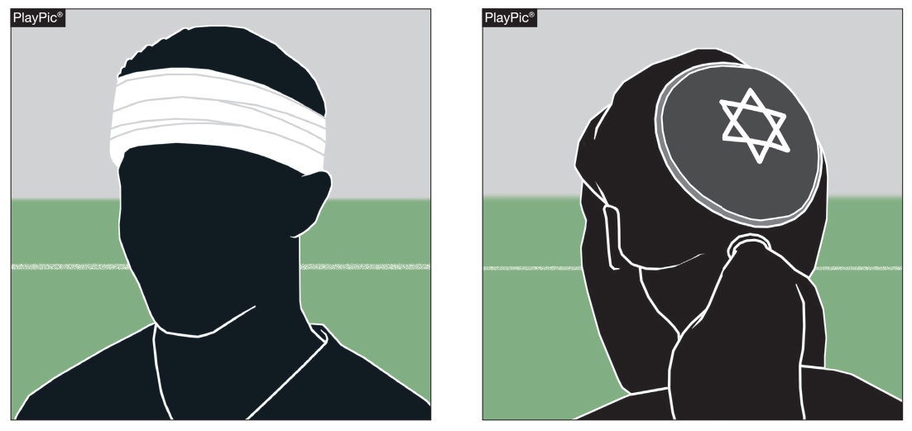
4-2-10: Other Equipment
FEDERATION DIFFERENCES
In PlayPic A and B, both items would be legal. In both A and B, wearing a head covering will require appropriate documentation showing state association approval to be allowed.
Notes:
4-2-10: Other Equipment
In PlayPic A and B, both items would be legal. In both A and B, wearing a head covering will require appropriate documentation showing state association approval to be allowed.

Slide 69
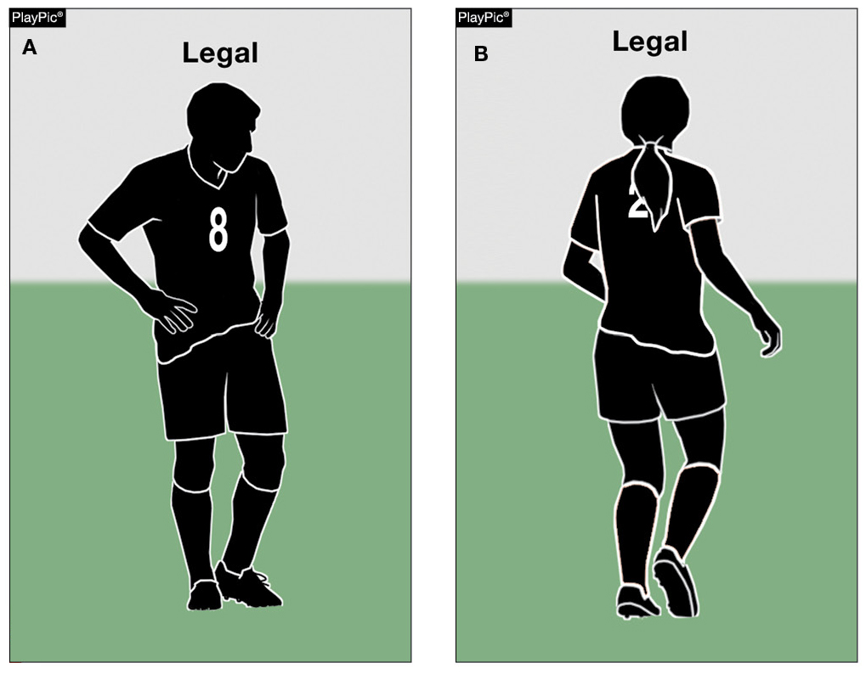
Rule 4-1-1A
Uniform
FEDERATION DIFFERENCES
Players are no longer required to tuck in jerseys.
Notes:
RULE 4-1-1a TUCKED SHIRTS
Players are no longer required to tuck in jerseys.

Slide 70
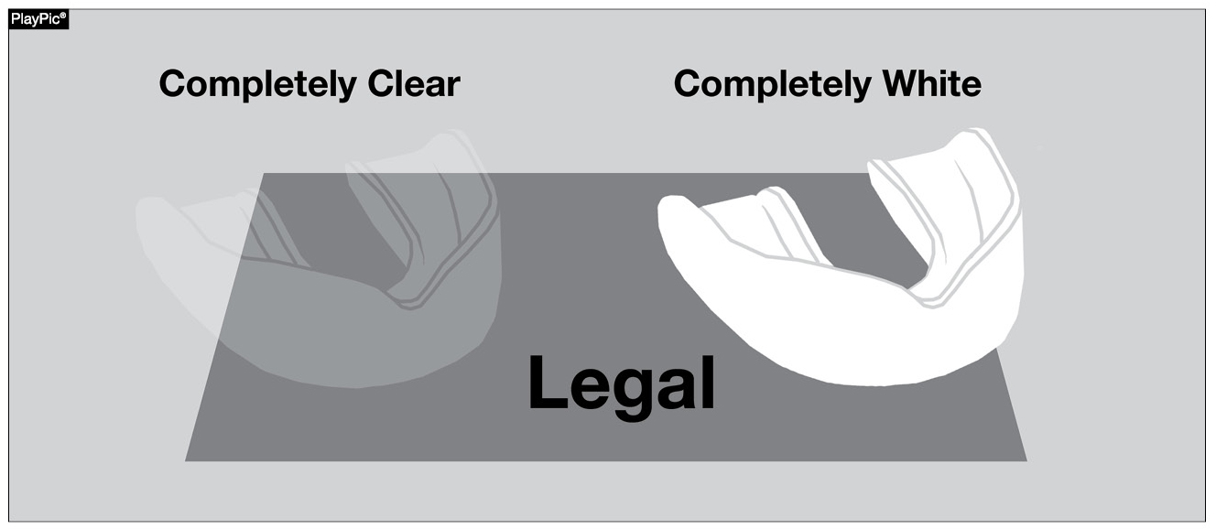
Rules 4-2-7E, F (DELETED) EQUIPMENT
FEDERATION DIFFERENCES
Tooth and mouth protectors (intraoral), if worn, are no longer illegal if completely white or clear.
Notes:
Rules 4-2-7e, f EQUIPMENT
Tooth and mouth protectors (intraoral), if worn, are no longer illegal if completely white or clear.

Slide 71
FEDERATION DIFFERENCES
RULE 5 - THE OFFICIALS
OFFICIALS
  HEAD REFEREE
  REFEREE OR ASSISTANT REFEREE
  SHALL CHANGE TO DIFFERENT JERSEY (GOLD OR BLACK)
PREGAME
  HEAD REFEREE
    MEET WITH GAME ADMINISTRATOR
    INSPECT AND APPROVE GAME BALLS, FIELD, ETC.
    CONDUCT AN INFORMAL INSPECTION OF THE PLAYERS
    REVIEW SPECIFIC DUTIES SCORER, TIMER, ASSISTANT REFEREES
    CONDUCT A PRE-GAME CONFERENCE WITH CAPTAINS AND HEAD COACH
Notes:
The “Sportsmanship Statement” should be given to both coaches and captains sometime during the pregame.

Slide 72
FEDERATION DIFFERENCES
RULE 5 - THE OFFICIALS
PREGAME (CONTINUED)
  REFEREE OR ASSISTANT REFEREES
    ASSIST HEAD REFEREE
    REVIEW DUTIES WITH BALL HOLDERS
    ASSIST WITH PRE-GAME CONFERENCE
DURING GAME
  BOTH OFFICIALS
    WHEN SIGNALING, USE OFFICIAL NFHS SOCCER SIGNALS
    JURISDICTION ENDS......
  HEAD REFEREE
    DECIDES IF 2 DISAGREE (GOAL ONLY)
AFTER THE GAME
  HEAD REFEREE
    VERIFIES THE SCORE
    REPORTS, IN WRITING, ALL DISQUALIFICATIONS (CAUTIONS ALSO FOR GISA)

Slide 73
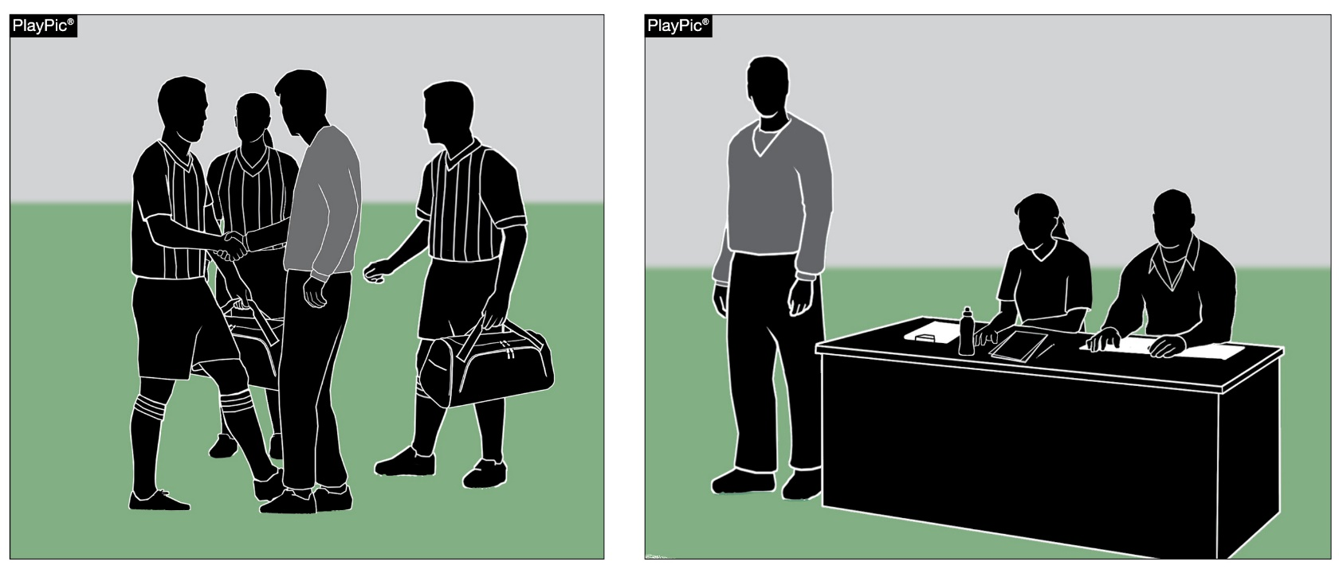
FEDERATION DIFFERENCES
RULE 5 - THE OFFICIALS (PRE-GAME CONFERENCE)
The site administrator should indicate his/her general location for the contest so that the referees know where to look if there is a need.
Notes:
You must meet the “Site Administrator “ and get his contact information and location he’ll be sitting if only event he is monitoring

Slide 74
FEDERATION DIFFERENCES
RULE 5 - THE OFFICIALS (PRE-GAME CONFERENCE)
ARE YOUR PLAYERS PROPERLY AND LEGALLY EQUIPPED?
REMIND THE HEAD COACHES AND CAPTAINS THAT NFHS & GHSA EMPHASIZES GOOD SPORTSMANSHIP
CONDUCT A COIN-TOSS 5 MINUTES BEFORE START OF PLAY
  THE WINNER OF THE COIN TOSS HAS THE SAME OPTIONS AS FIFA
Notes:
The “Sportsmanship Statement” should be given to both coaches and captains sometime during the pregame. Only recommend one captain and one coach from each team

Slide 75
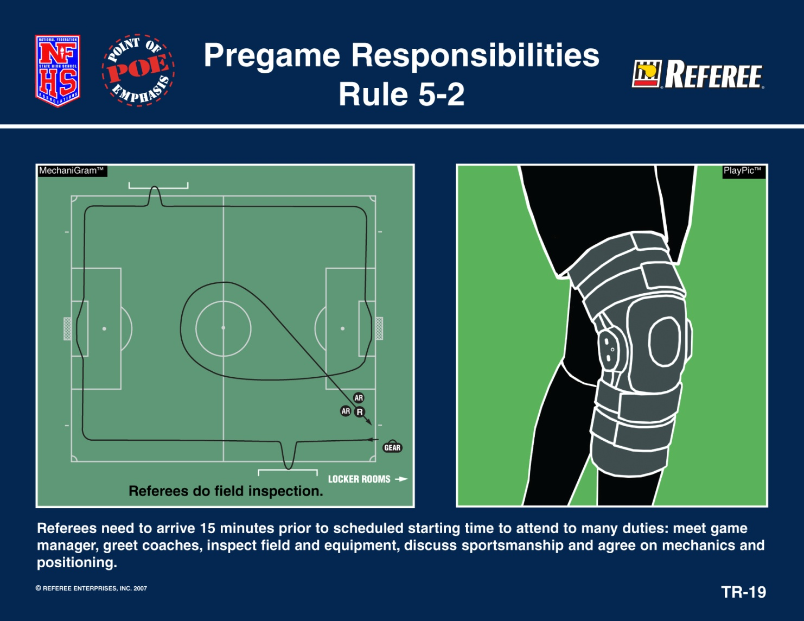
FEDERATION DIFFERENCES
RULE 5 - THE OFFICIALS

Slide 76
Team Member Equipment Check
FEDERATION DIFFERENCES
Because of the number of recent rule changes involving uniforms and equipment, officials are encouraged to informally check the equipment of team members before the game to prevent possible player-equipment violations.
Notes:
Team Member Equipment Check
Because of the number of recent rules changes involving uniforms and equipment, officials are encouraged to informally check the equipment of team members before the game to prevent possible player equipment violations occurring during the game.

Slide 77
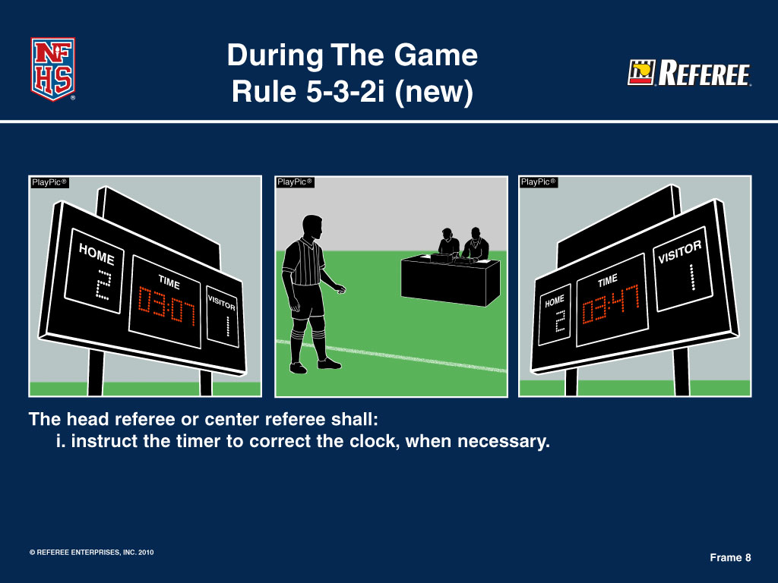
FEDERATION DIFFERENCES
RULE 5 - THE OFFICIALS

Slide 78
FEDERATION DIFFERENCES
RULE 5 - THE OFFICIALS (SPORTSMANSHIP STATEMENT)
“The GHSA and its member schools have made a commitment to promote good sportsmanship by student/athletes, coaches, and spectators at all GHSA sanctioned events. Profanity, degrading remarks, and intimidating actions directed at officials, competitors, or other spectators will not be tolerated, and are grounds for removal from the event site. Spectators are not allowed to enter the competition area during warm-ups or while the contest is being conducted. Thank you for your cooperation in the promotion of good sportsmanship at today’s event.”
Notes:
The “Sportsmanship Statement” should be given to both coaches and captains sometime during the pregame.

Slide 79
FEDERATION DIFFERENCES
GHSA Constitution & By-laws Guidance and Direction for Referees
Teams arriving late for a contest by thirty (30) minutes or more shall forfeit the match and shall pay the officials unless prior arrangements are made in a timely manner, and both teams agree to start the game late or reschedule it.
Consideration will also be given to emergency situations over which the traveling school has no control.
The host school has the responsibility of notifying the officials of these changes.

Slide 80
FEDERATION DIFFERENCES
GHSA Constitution & By-laws Guidance and Direction for Referees
The “Host School” must provide a private and secure area for the game officials to meet prior and following the contest.
The “Host School” is responsible to have visible security on site prior to , during, and following each contest until the time the contest officials exited the property.

Slide 81
FEDERATION DIFFERENCES
GHSA Constitution & By-laws Guidance and Direction for Referees
The Contest Officials Handbook and Accountability Program is located on the GHSA website under Officials at “GHSA Contest Officials Handbook and Accountability Program” (revised 8/14/19) https://www.ghsa.net/sites/default/files/documents/officials/Officiating_Handbook_8-14-19.pdf
SOCCER
Handle by local associations
Notes:
On the GHSA website under “Officials” there is a link to the revised handbook.

Slide 82
FEDERATION DIFFERENCES
RULE 5 - THE OFFICIALS
THESE ARE THE OFFICIAL SIGNALS TO BE USED IN ALL HIGH SCHOOL GAMES
  IN A DUAL SYSTEM GAME, THIS IMPROVES COMMUNICATION BETWEEN OFFICIALS, COACHES, AND THE FANS
  IN A THREE-MAN SYSTEM, THE CENTER IS TO USE THESE SIGNALS
    THE ASSISTANT REFEREES COULD USE THESE SIGNALS TO DISCRETELY COMMUNICATE INFORMATION TO THE CENTER REFEREE

Slide 83

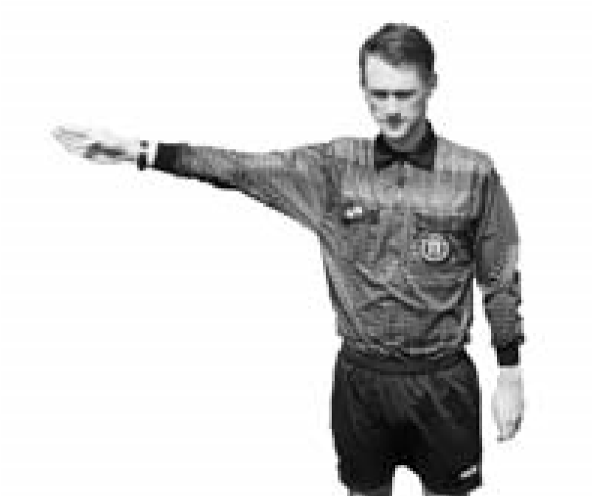
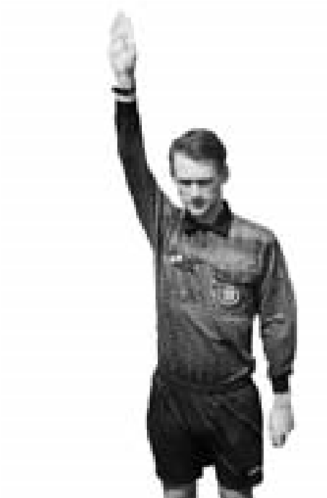

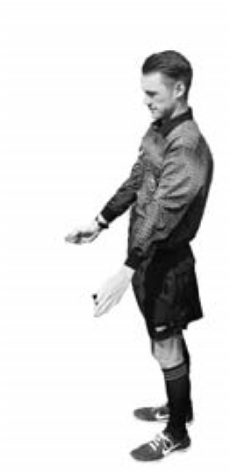
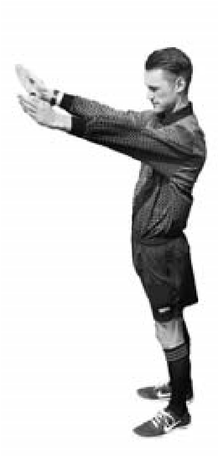
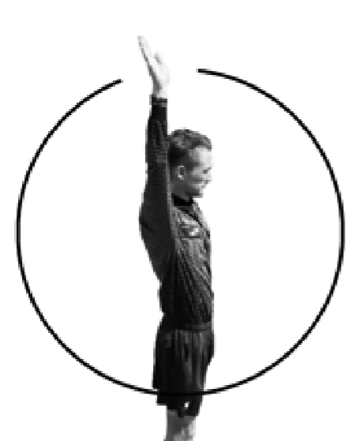
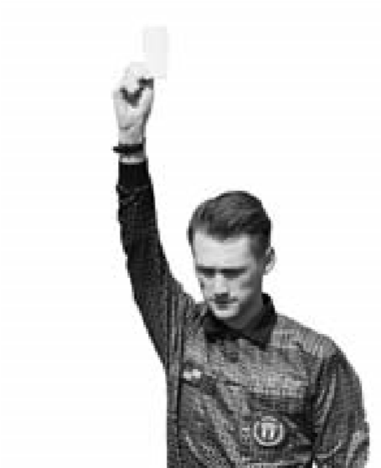
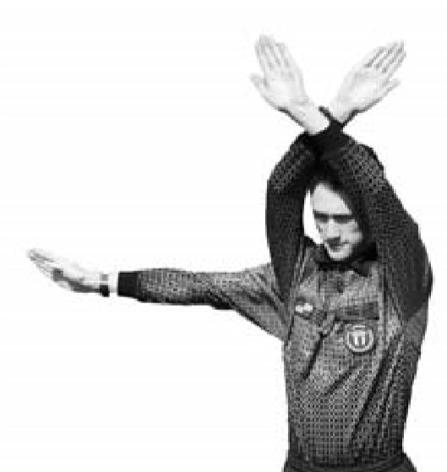
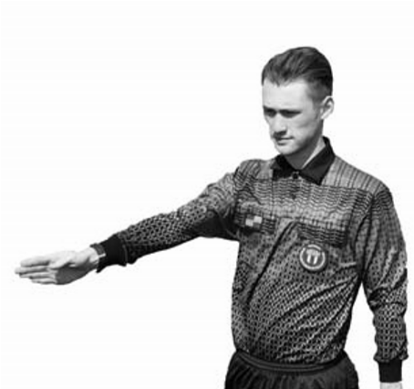
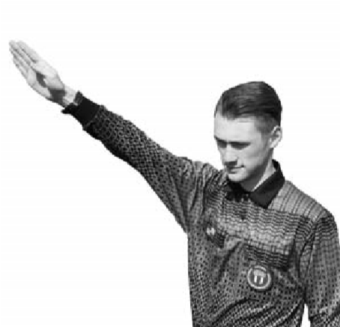
NFHS Official Soccer Signals
1
2
3-1
3-2
4
Direct free kick
Indirect
(
points in direction of kick
Play On
Timeout
)
free kick
5
6
7
8
9
1
➤
➤
2
NFHS Official Soccer Signals
➤
➤
Penalty Kick
(
point to spot),
Corner Kick
(
Wind-up to start
Goal Kick
Caution/
(
point to corner
(
point to goal area
)
Goal
clock)
)
ejection
Notes:
The Play on signal my be either one or two arms raised

Slide 84
NFHS Official Soccer Signals
Throw In
Substitution
Foul
Corner Kick
Goal Kick
Stop Play Offside
Offside
Far side
Offside
Middle
Offside
Near side

Slide 85
FEDERATION DIFFERENCES
RULE 6 - BALL HOLDERS, TIMER, AND SCORER
HOME TEAM PROVIDES
  2 BALL HOLDERS
  OFFICIAL TIMER
    SIGNALS FOR SUBSTITUTIONS
  OFFICIAL SCORER
    COMPLETE LINEUP
    LINEUP MAY BE MODIFIED AFTER START OF MATCH

Slide 86
FEDERATION DIFFERENCES
RULE 7 - DURATION OF THE GAME AND LENGTH OF PERIODS
2 EQUAL HALVES (IN GEORGIA)
  VARSITY 40 MINUTES
  9TH & JV 35 MINUTES
  7TH & 8TH 30 MINUTES
FEDERATION SAYS YOU MAY PLAY QUARTERS
TO SHORTEN MATCH
  STATE ASSOCIATION
  AGREEMENT OF COACHES
  ORDERED BY HEAD REFEREE
DETERMINE BEFORE GAME OR 2ND HALF BEGINS
SUSPENDED GAME CONSIDERED COMPLETE IF 1st HALF HAS BEEN PLAYED ON GAMES THAT ARE NOT OF THE SAME CLASSIFICATION

Slide 87
FEDERATION DIFFERENCES
RULE 7 - DURATION OF THE GAME AND LENGTH OF PERIODS
HALFTIME 10 MINUTES UNLESS COACHES DECIDE
  PLAYER(S) DISQUALIFIED, DURING HALFTIME, DOES NOT EFFECT TEAMS’ ON-FIELD NUMBERS
  5 MINUTES BETWEEN REGULATION AND FIRST OVER-TIME PERIOD
  2 MINUTES BETWEEN OVER-TIME PERIODS
TIE GAME (DIFFERENT CLASSIFICATIONS)
  NO OVERTIME INVOKED WHEN REGULATION PLAY ENDS WITH A TIE SCORE,
  UNLESS BOTH COACHES AGREE AND INFORM THE MATCH OFFICIALS PRIOR TO THE START OF PLAY
TIE GAME (SAME CLASSIFICATION & PLAY OFFS ONLY!)
  THE OVERTIME WILL CONSIST OF TWO (2) TEN-MINUTE PERIODS, WHICH WILL PLAYED IN THEIR ENTIRETY
  A COIN TOSS SHALL TAKE PLACE TO DETERMINE WHICH TEAM WILL PUT THE BALL IN PLAY FOR THE FIRST OVERTIME PERIOD.
  IF THE SCORE REMAINS TIED FOLLOWING THE OVERTIME PERIOD, A “SHOOTOUT” OF PENALTY KICKS WILL DETERMINE THE WINNER.
  THE PENALTY KICKS PROCEDURE WILL BE COVERED UNDER RULE 14
Notes:
Note: Only one fifteen minute overtime period!!!

Slide 88
FEDERATION DIFFERENCES
GHSA WHITEBOOK RULES
Games involving schools from different classifications:
  Up to two-hour cumulative delay may be used to complete the contest
  Contest cannot go past GHSA 11:30 p.m. curfew
  If the contest is terminated prior to the end of the 1st half, “no contest” is declared
  If the contest is terminated after the 1st half is completed, the score at that point is final
Games involving schools from the same classification:
  The two-hour time delay does not exist
  The 11:30 p.m. GHSA curfew is waived (NOT the local government curfew)
  School administrators may agree to terminate the game and resume play at the point of interruption
  The trailing team may choose not to resume play at a later date

Slide 89
FEDERATION DIFFERENCES
RULE 7 - DURATION OF THE GAME AND LENGTH OF PERIODS
POINT DIFFERENCE MAY TERMINATE
  THE MINUTES SHOWN ARE REPRESENTATIVE OF A VARSITY MATCH
    SUB-VARSITY IS HALF OF THE DURATION OF THEIR HALF
  IF A TEAM IS 7 OR MORE GOALS DOWN AT THE MIDPOINT OF THE FIRST HALF, THE HALF WILL END AND THE SECOND HALF WILL BE 20 MINUTES IN LENGTH
  IF A TEAM IS 7 OR MORE GOALS DOWN AT HALFTIME, THE SECOND HALF WILL BE 20 MINUTES IN LENGTH
  WHEN A TEAM TRAILS BY TEN (10) OR MORE GOALS DOWN AT HALFTIME, THE GAME WILL BE TERMINATED

Slide 90
FEDERATION DIFFERENCES
RULE 7 - DURATION OF THE GAME AND LENGTH OF PERIODS
STOP THE CLOCK FOR THE FOLLOWING:
  PENALTY KICK
  ISSUING CARDS
  AFTER A GOAL
  ANYTIME THE REFEREE SAYS
    INJURY
    DELAY OF GAME
    SUBSTITUTION IN LAST 5-MINUTES OF SECOND HALF
    OTHER ???

Slide 91
FEDERATION DIFFERENCES
RULE 8 - THE START OF PLAY
START OF PLAY
  FIFA
    SIGNAL FROM REFEREE
    BALL MAY MOVE IN ANY DIRECTION TO BE INPLAY
  HIGH SCHOOL
    REFEREE SIGNALS WITH WHISTLE
    BALL MAY MOVE IN ANY DIRECTION TO BE INPLAY
    CANNOT SCORE DIRECTLY IN YOUR OWN GOAL
COIN TOSS – SAME FOR BOTH ASSOCIATIONS

Slide 92
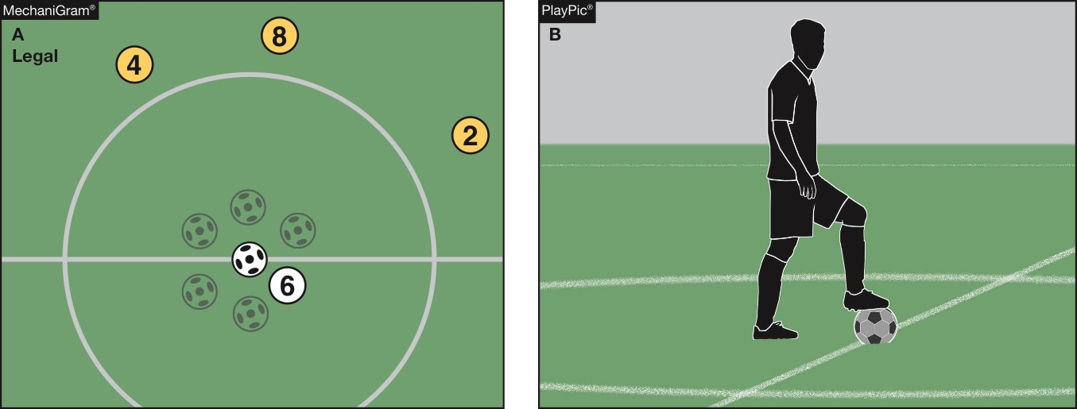
FEDERATION DIFFERENCES
Rule 8-1-3
Kickoff
The ball is in play when it is kicked and clearly moves in any direction (MechaniGram A). The ball is not in play until it has clearly moved (PlayPic B).
Notes:
RULE 8-1-3 - KICKOFF
The ball is in play when it is kicked and clearly moves in any direction (MechaniGram A). The ball is not in play until it has clearly moved (PlayPic B).

Slide 93
FEDERATION DIFFERENCES
RULE 9 - BALL IN AND OUT OF PLAY
REFEREE SOUNDS HIS WHISTLE
  OUT OF BOUNDS… IF NEEDED
  FOULS
  FOR CERTAIN RESTARTS
    PENALTY KICK
    AFTER SUBSTITUTION
    AFTER CAUTIONS
    AFTER DISQUALIFICATIONS
    AFTER INJURY TIMEOUT
    AFTER ENCROACHMENT
    WHEN NEEDED TO END CONFUSION
TEMPORARY SUSPENSIONS
  A DROP BALL THAT CHANGED THIS YEAR

Slide 94
Rule 9-1-1b - ball in and out of play
FEDERATION DIFFERENCES
The ball is out of play when:
a. it has completely crossed the goal line or touch line, whether on the ground or in the air;
b. the ball touches an official and remains on the field; and
1. a team starts a promising attack;
2. goes directly into the goal;
  3. possession changes
Notes:
The ball is out of play when:
a. it has completely crossed the goal line or touch line, whether on the ground or in the air;
b. the ball touches an official and remains on the field; and
1. a team starts a promising attack;
2. goes directly into the goal;
3. possession changes

Slide 95
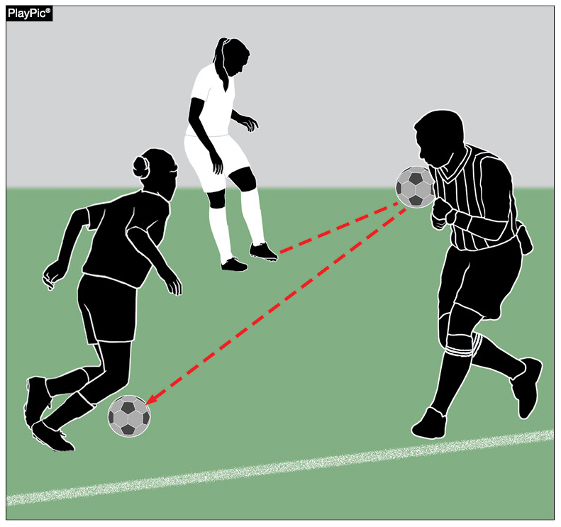
Rule 9-1-1B
Ball in or out of play
FEDERATION DIFFERENCES
A team should not gain an advantage when the ball touches the referee and stays on the field, including when it goes to an opponent (as shown), goes into the goal or starts a promising attack.
Restart with a drop ball to a player of the team last in possession at the spot where it was last touched the referee, player, or outside agent.
Notes:
A team should not gain an advantage when the ball touches the referee and stays on the field, including when it goes to an opponent (as shown), goes into the goal or starts a promising attack.
b. Restart with a drop ball to a player of the team last in possession at the spot where it was last touched the referee, player, or outside agent.

Slide 96
Rule 9-2-1 drop ball
FEDERATION DIFFERENCES
ART. 1…The game is restarted with a drop ball:
a. when the ball is caused to go out-of-bounds by two opponents simultaneously;
b. when the ball becomes deflated; (2-2-4)
c. following a temporary suspension of play for an injury or unusual situation; (except as noted in 14-1-7).
d. when simultaneous fouls of the same degree occur by opponents; or
e. when the ball touches an official as per 9-1-1b.
Notes:
ART. 1…The game is restarted with a drop ball:
a. when the ball is caused to go out-of-bounds by two opponents simultaneously;
b. when the ball becomes deflated; (2-2-4)
c. following a temporary suspension of play for an injury or unusual situation; (except as noted in 14-1-7).
d. when simultaneous fouls of the same degree occur by opponents; or
e. when the ball touches an official as per 9-1-1b.

Slide 97
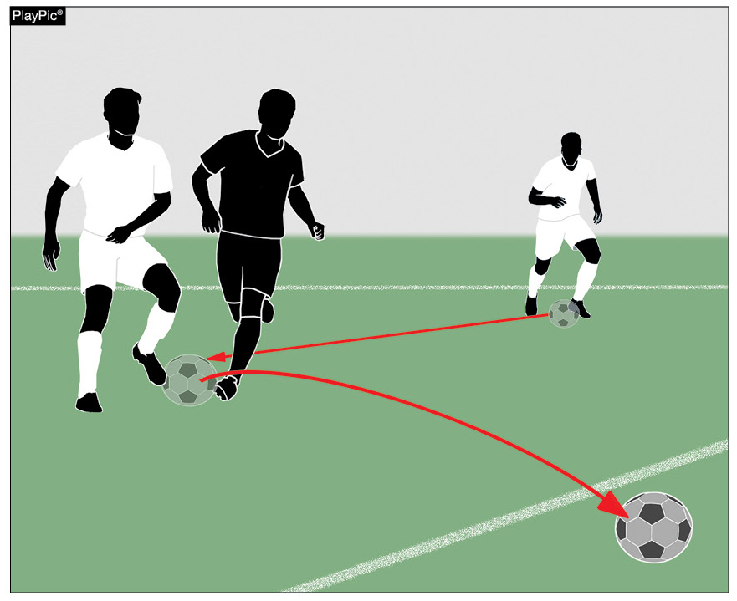
Rules 9-2-2, 9-2-3
Drop Ball
FEDERATION DIFFERENCES
If the ball was caused to go out of bounds by two opponents simultaneously, the ball is dropped five yards inside the boundary line to one player of the team in possession of the ball prior to the simultaneous touch, unless this was in the goal area.
Notes:
RULES 9-2-2; 9-2-3 DROP BALL
If the ball was caused to go out of bounds by two opponents simultaneously, the ball is dropped five yards inside the boundary line to one player of the team in possession of the ball prior to the simultaneous touch, unless this was in the goal area.

Slide 98
Rule 9-2-3 - drop ball
FEDERATION DIFFERENCES
ART. 3…
The ball is dropped by an official from waist level to the ground. The referee drops the ball to one player of the team that last possessed the ball at the position where it was last touched by a player(s), an outside agent or match official. If when play was stopped, the ball was in the penalty area or the last touch, by either team, was in the penalty area, the ball is dropped to the defending team’s goalkeeper with all opposing players outside the penalty area. In all cases, all other players must remain at least 4 yards from the ball until it is in play.
Notes:
ART. 3…
The ball is dropped by an official from waist level to the ground. The referee drops the ball to one player of the team that last possessed the ball at the position where it was last touched by a player(s), an outside agent or match official. If when play was stopped, the ball was in the penalty area or the last touch, by either team, was in the penalty area, the ball is dropped to the defending team’s goalkeeper with all opposing players outside the penalty area. In all cases, all other players must remain at least 4 yards from the ball until it is in play.

Slide 99
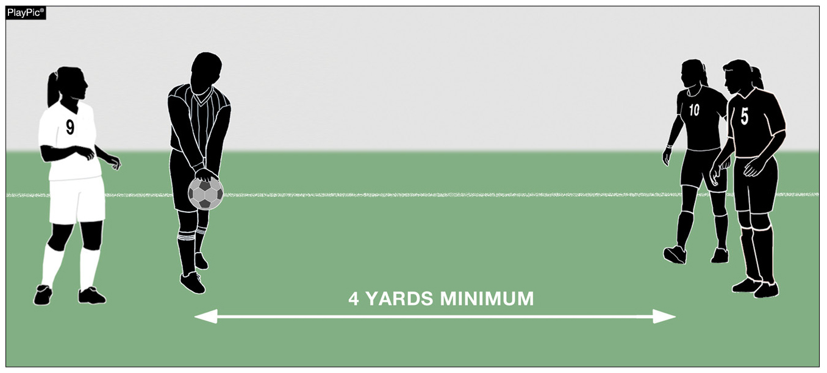
Rules 9-2-2, 9-2-3 Drop Ball
FEDERATION DIFFERENCES
A drop ball goes to one player of the team that last possessed the ball. The ball is dropped where it was last touched by a player, an outside agent or match official unless the ball was in the penalty area or the last touch by either team was in the penalty area.
Notes:
A drop ball goes to one player of the team that last possessed the ball. The ball is dropped where it was last touched by a player, an outside agent or match official unless the ball was in the penalty area or the last touch by either team was in the penalty area.

Slide 100
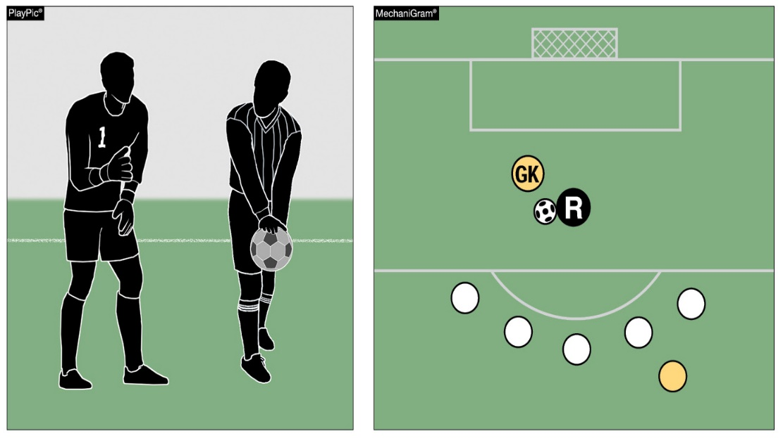
Rules 9-2-2, 9-2-3 Drop Ball
FEDERATION DIFFERENCES
If the ball was in the penalty area or the last touch by either team was in the penalty area when play was stopped, the ball is dropped to the defending team’s goalkeeper. All opposing players must be outside the penalty area and all players must be at least four yards from the ball.
Notes:
If the ball was in the penalty area or the last touch by either team was in the penalty area when play was stopped, the ball is dropped to the defending team’s goalkeeper. All opposing players must be outside the penalty area and all players must be at least four yards from the ball.

Slide 101
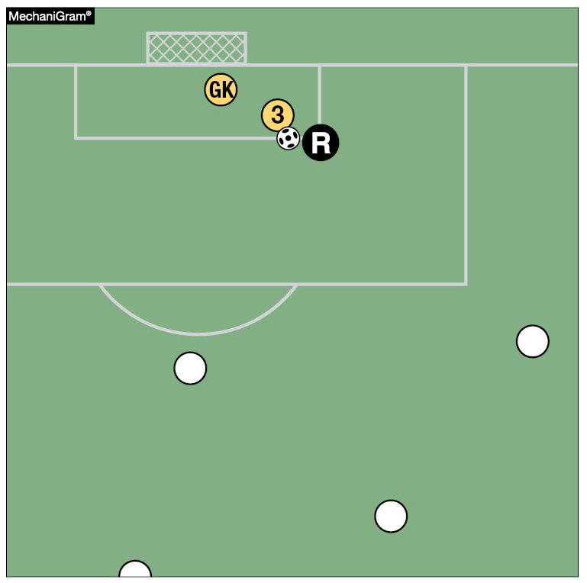
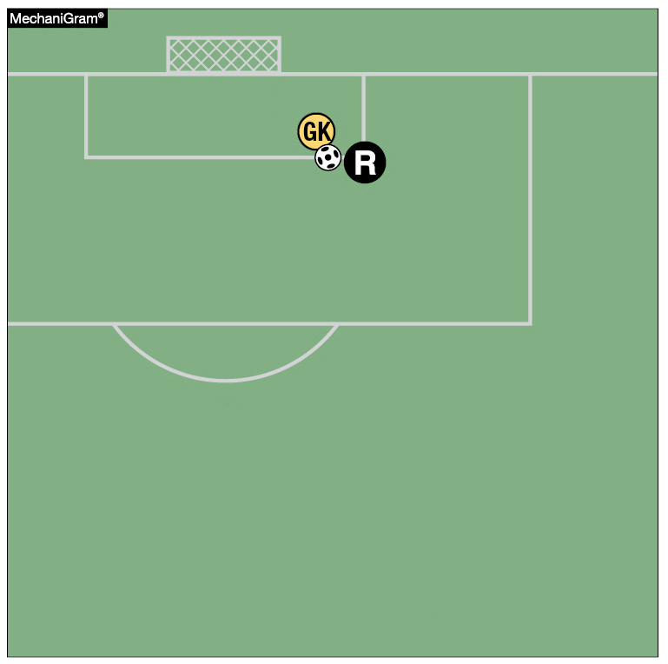
Rules 9-2-2, 9-2-3 Drop Ball
FEDERATION DIFFERENCES
If the ball was in the goal area when play was stopped, it is dropped to the goalkeeper on that part of the goal-area line which runs parallel to the goal line nearest the location where the ball was when play was stopped.
Notes:
If the ball was in the goal area when play was stopped, it is dropped to the goalkeeper on that part of the goal-area line which runs parallel to the goal line nearest the location where the ball was when play was stopped.

Slide 102
FEDERATION DIFFERENCES
RULE 10 - SCORING
RULE 10 – NO DIFFERENCES
FORFEITS (HANDLED BY GHSA)
  IF NOT STARTED 1-0
  IF TEAM AHEAD 1-0
  IF TEAM BEHIND SCORE OF GAME
WITH ALL FORFEITS, A REPORT MUST BE SUBMITTED TO GHSA THROUGH YOUR ASSOCIATION

Slide 103
FEDERATION DIFFERENCES
RULE 11 - OFFSIDE
NO DIFFERENCES
BUT….
Notes:
The new definition of gaining advantage by being in that position and receiving the ball from a deliberate play and not a deliberate save….

Slide 104
FEDERATION DIFFERENCES
Offside Restarts:
Location of Offside Restart
Position A
Position B
The restart for offside infractions is an indirect free kicks taken from the spot where the offending player interfered with play, interfered with an opponent or gained advantage by being in that position.
Notes:
RESTARTS: LOCATION OF OFFSIDE RESTART
The restart for offside infractions is an indirect free kicks taken from the spot where the offending player interfered with play, interfered with an opponent or gained advantage by being in that position.

Slide 105
FEDERATION DIFFERENCES
RULE 12 - FOULS AND MISCONDUCT
HIGH SCHOOL A PLAYER SHALL NOT
FIFA CARELESS, RECKLESS, EXCESSIVE FORCE
DEFINES FAIR CHARGE
VERY PROTECTIVE OF THE GOALKEEPER
  IN POSSESSION 12.4.3
  DISQUALIFICATION-FLAGRANTLY 12.4.2A
OBSTRUCTION
DANGEROUS PLAY
  - HIGH SCHOOL SELF, TEAMMATE, OR OPPONENT
  - FIFA SELF & OPPONENT

Slide 106
FEDERATION DIFFERENCES
RULE 12 - FOULS AND MISCONDUCT
DOGSO – SAME AS FIFA
GOALKEEPER
  CANNOT CHARGE GOALKEEPER UNLESS:
    HE IS OBSTRUCTING
    HE IS PLAYING AS FIELD PLAYER
NOTIFICATION OF ALL CARDS MUST BE GIVEN TO EACH COACH
TAUNTING - RED CARD OFFENSE
Notes:
This is notifications to the coaches and NOT an explanation

Slide 107
FEDERATION DIFFERENCES
RULE 12 - FOULS AND MISCONDUCT
MISCONDUCT - PLAYERS, COACH, TEAM OFFICIALS
  SIT OUT 1 OR 2 GAME(S)
  DISQUALIFIED COACH......LEAVE THE AREA OF THE GAME (SIGHT & SOUND)
  DISQUALIFIED PLAYER...…LEAVE THE FIELD OF PLAY (ONLY SENT AWAY, IF WITH ADULT SUPERVISION)
  DISQUALIFIED TRAINER….IF ONLY ONE THERE, NEAR ENOUGH TO BE CALLED BACK FOR TREATMENT OF INJURIES
U.S.L.C. FOR THE BENCH IFK
  IF YOU DON’T KNOW WHO DID IT THEIR COACH GETS THE CARD

Slide 108
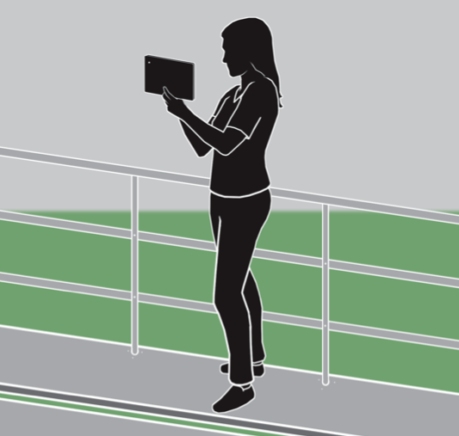
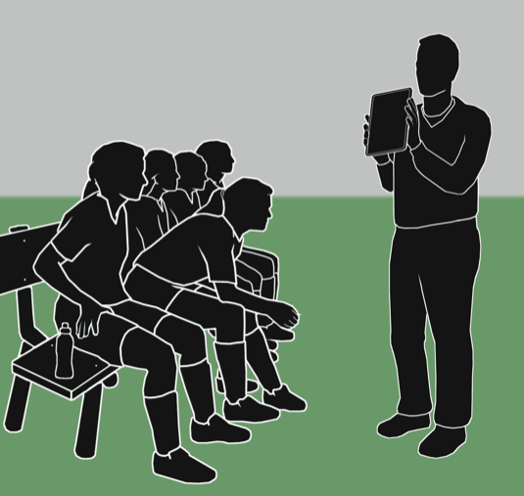
FEDERATION DIFFERENCES
RULE 12 - FOULS AND MISCONDUCT
While use of electronic communication devices with on-field players during play is still prohibited, the use of electronic devices on the sideline is allowed.

Slide 109
FEDERATION DIFFERENCES
RULE 13 - FREE KICK
DESCRIBES WHEN TO AWARD ALL FREE KICKS

Slide 110
Rule 13-2-1j (new)
FEDERATION DIFFERENCES
Provides for a penalty for a player(s), coach or bench personnel who enters or leaves the field without permission from an official and interferes with play or an official.
Notes:
Rule 13-2-1j (new)
Provides for a penalty for a player(s), coach or bench personnel who enters or leaves the field without permission from an official and interferes with play or an official.

Slide 111
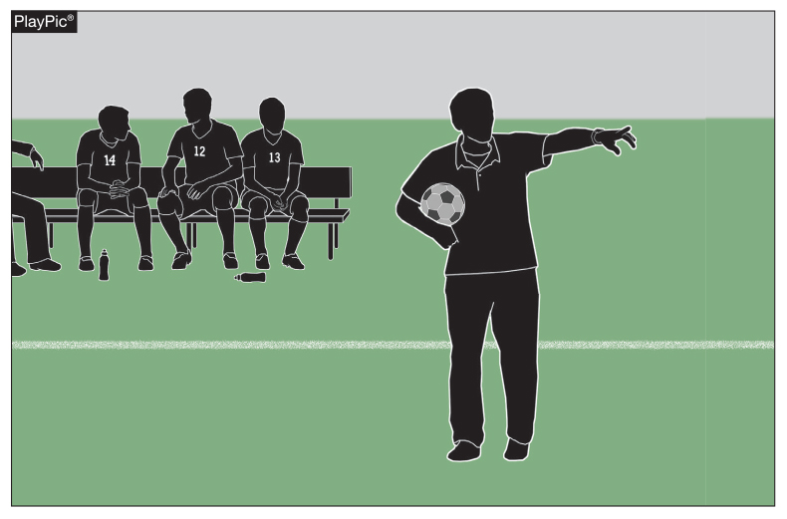
13-2-1j: Free Kick: When Awarded
FEDERATION DIFFERENCES
A player, coach or bench personnel enters or leaves the playing field without permission from the official and interferes with play or an official shall be penalized with a direct free kick from the point of the infraction.
Notes:
13-2-1j: Free Kick: When Awarded
A player, coach or bench personnel enters or leaves the playing field without permission from the official and interferes with play or an official shall be penalized with a direct free kick from the point of the infraction.

Slide 112
Rule 13-3-1 how taken – FREE KICK
FEDERATION DIFFERENCES
ART. 1…
Players opposing the kicker shall be at least 10 yards from the ball until it is kicked, unless they are standing on their own goal line between the goal posts. If the free kick is awarded to the defending team in its penalty area, players opposing the kicker shall be outside the penalty area at least 10 yards from the ball and shall remain there until the ball is in play. Where 3 or more defending team players form a wall, all attacking team players must remain at least 1 yard from the wall until the ball is in play.
Notes:
Players opposing the kicker shall be at least 10 yards from the ball until it is kicked, unless they are standing on their own goal line between the goal posts. If the free kick is awarded to the defending team in its penalty area, players opposing the kicker shall be outside the penalty area at least 10 yards from the ball and shall remain there until the ball is in play. Where 3 or more defending team players form a wall, all attacking team players must remain at least 1 yard from the wall until the ball is in play.

Slide 113
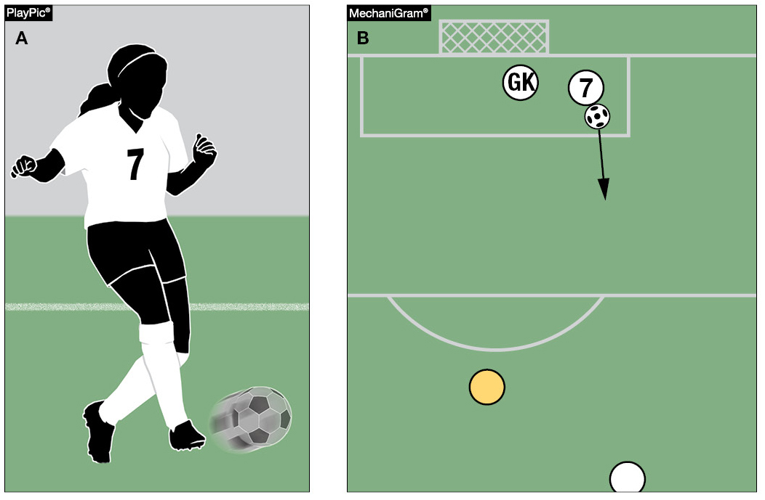
Rule 13-3-1 Free Kick - How taken
FEDERATION DIFFERENCES
On a free kick taken from within a team’s penalty area, the ball is in play when it is kicked and moves (PlayPics A and B).
Notes:
RULE 13-3-1 HO TAKEN – FREE KICK
On a free kick taken from within a team’s penalty area, the ball is in play when it is kicked and moves (PlayPics A and B).

Slide 114
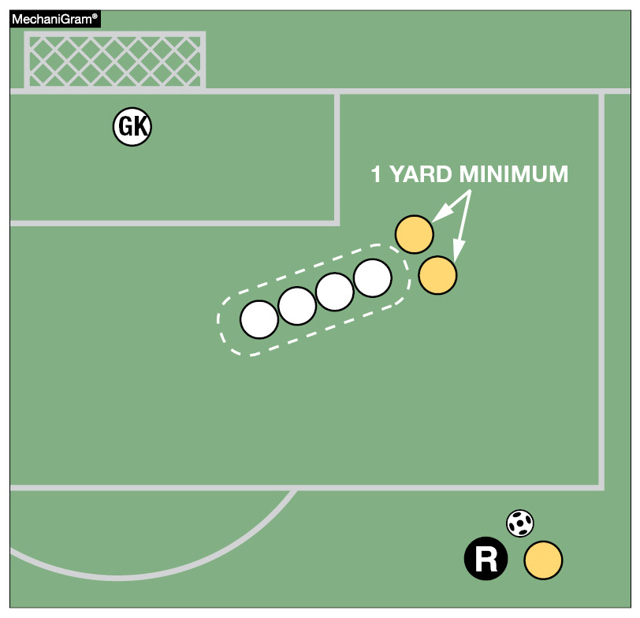
Rule 13-3-1 Free Kick - How taken
FEDERATION DIFFERENCES
When three or more defending team players form a wall, all attacking team players must remain at least one yard from the wall until the ball is in play.
Notes:
When three or more defending team players form a wall, all attacking team players must remain at least one yard from the wall until the ball is in play.

Slide 115
Rule 13-3-2 Free Kick - How taken
FEDERATION DIFFERENCES
ART. 2…
The ball shall be kicked while it is stationary on the ground at the spot specified by the official. To be in play, the ball shall be moved in any direction. Failure to kick the ball as specified shall result in a rekick.
Notes:
ART. 2…
The ball shall be kicked while it is stationary on the ground at the spot specified by the official. To be in play, the ball shall be moved in any direction. Failure to kick the ball as specified shall result in a rekick.

Slide 116
Rule 13-3-4 new how taken – free kick
FEDERATION DIFFERENCES
NEW ART. 4…
For indirect kicks, the referee shall signal an indirect kick (using Official NFHS Soccer Signals Rule 5-3-1b) by raising an arm above the head; this signal shall be maintained until the kick is taken and the ball touches another player or goes out of play. If the referee fails to signal the kick is indirect and the ball goes directly into the opponent's goal, the kick shall be retaken.
Notes:
NEW ART. 4…
For indirect kicks, the referee shall signal an indirect kick (using Official NFHS Soccer Signals Rule 5-3-1b) by raising an arm above the head; this signal shall be maintained until the kick is taken and the ball touches another player or goes out of play. If the referee fails to signal the kick is indirect and the ball goes directly into the opponent's goal, the kick shall be retaken.

Slide 117
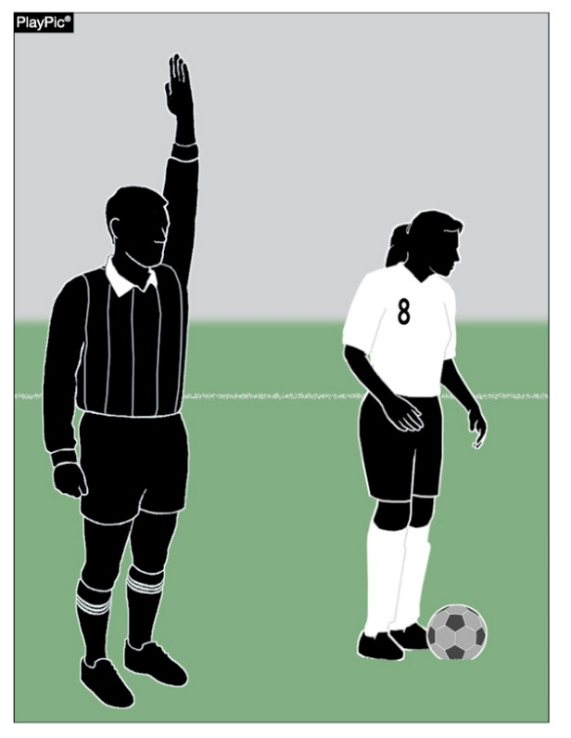
Rule 13-3-4 new how taken – free kick
FEDERATION DIFFERENCES
The referee must show and hold the indirect kick signal until the kick is taken and the ball is touched by any other player. Failure of the referee to correctly signal indirect free kick when the ball goes directly into the opponent’s goal results in a re-kick.
Notes:
The referee must show and hold the indirect kick signal until the kick is taken and the ball is touched by any other player. Failure of the referee to correctly signal indirect free kick when the ball goes directly into the opponent’s goal results in a re-kick.

Slide 118
FEDERATION DIFFERENCES
RULE 14 - PENALTY KICK
SUBSTITUTE MAY NOT TAKE THE KICK
FAKING A KICK IS NOT PERMITTED
STUTTER STEP IS PERMITTED WITH NO PAUSE
TEAMMATE OF THE KICKER INFRINGES RULE 14
  BALL GOES INTO GOAL - REKICK
  BALL GOES DIRECTLY OVER GOAL LINE – GOAL KICK
  BALL GOES OVER THE GOAL LINE LAST TOUCHED BY GOALKEEPER –IFK
  GOALKEEPER CATCHES BALL – PLAY CONTINUES

Slide 119
Rule 14-1-4 Penalty Kick
FEDERATION DIFFERENCES
Once the kicker starts the approach toward the ball, the kicker may not interrupt his or her movement. Failure to kick the ball as specified will be considered a violation by the attacking team, and the appropriate penalties shall apply.
Legal – Play continues with goalkeeper’s save
Illegal – Indirect Free Kick from Penalty Mark
Notes:
Rule 14-1-4 Penalty Kick
Once the kicker starts the approach toward the ball, the kicker may not interrupt his or her movement. Failure to kick the ball as specified will be considered a violation by the attacking team, and the appropriate penalties shall apply.

Slide 120
Rule 14-1-3 penalty kick
FEDERATION DIFFERENCES
ART. 3…
The opposing goalkeeper shall stand with at least one foot on or in-line with the goal line, facing the kicker, between the goal posts, and shall not be touching the goal posts, crossbar, or nets, until the ball is kicked. Lateral or forward movement is allowed, but the goalkeeper is not permitted to come off the line with both feet until the ball is in play.
Notes:
ART. 3…
The opposing goalkeeper shall stand with at least one foot on or in-line with the goal line, facing the kicker, between the goal posts, and shall not be touching the goal posts, crossbar, or nets, until the ball is kicked. Lateral or forward movement is allowed, but the goalkeeper is not permitted to come off the line with both feet until the ball is in play.

Slide 121

Rule 14-1-3 penalty kick
FEDERATION DIFFERENCES
The goalkeeper must stand with at least one foot on or in line with the goal line and shall not be touching the goal posts, cross bar or nets until the ball is kicked. While side to side movement is allowed, the goalkeeper is not allowed to leave the goal line with both feet until the ball is kicked and moves.
Notes:
The goalkeeper must stand with at least one foot on or in line with the goal line and shall not be touching the goal posts, cross bar or nets until the ball is kicked. While side to side movement is allowed, the goalkeeper is not allowed to leave the goal line with both feet until the ball is kicked and moves.

Slide 122
FEDERATION DIFFERENCES
RULE 14 - PENALTY KICK TO DECIDE A WINNER
The overtime will consist of two (2) ten-minute periods, which will be played to their entirety.
A coin toss shall take place to determine which team will put the ball in play for the first overtime period.
If the score remains tied following the overtime periods, a “shootout” of penalty kicks will determine the winner.
The head referee shall choose the goal at which the penalty kicks will be taken.
Each coach will select any five (5) eligible players (including goalkeeper) to take the kicks.

Slide 123
FEDERATION DIFFERENCES
RULE 14 - PENALTY KICK TO DECIDE A WINNER (cont.)
A coin toss shall be held with the team winning the toss having the choice of kicking first or last.
Teams will alternate kickers, and there is no follow up on the kicks.
The defending team may change goalkeepers prior to each kick.
Following five kicks from each team, the team with the greater number of successful kicks will be given one (1) point and declared the winner.
If the same number of penalty kicks are successful for each team, each coach will select five (5) different eligible players who will kick in a “sudden victory” situation. Each team will have an opportunity to kick in each round of the sudden victory procedure.
If there is no “sudden victory” winner after five (5) kicks, the process will be repeated until a winner is determined.

Slide 124
FEDERATION DIFFERENCES
RULE 15 - THROW IN
IF THE BALL DOES NOT ENTER THE FIELD, THE OPPONENTS ARE AWARDED THE THROW IN

Slide 125
Rule 16-1-2; Rule 16-1-3 Goal Kick
FEDERATION DIFFERENCES
ART. 2…
Players opposing the kicker shall remain outside the penalty area until the ball is in play.
ART. 3…
Once spotted, the ball shall be kicked from the ground from any point within the goal area by a player of the defending team. The ball is in play when it is kicked and moves.
Notes:
ART. 2…
Players opposing the kicker shall remain outside the penalty area until the ball is in play.
ART. 3…
Once spotted, the ball shall be kicked from the ground from any point within the goal area by a player of the defending team. The ball is in play when it is kicked and moves.

Slide 126

Rule 16-1-2; Rule 16-1-3 Goal Kick
FEDERATION DIFFERENCES
Players opposing the kicker shall remain outside the penalty area until the ball is in play.
Once spotted on the ground and within the goal area for a goal kick, the ball is in play when it has been kicked and moves.
Notes:
RULES 16-1-2; 16-1-3 GOAL KICK
a. Players opposing the kicker shall remain outside the penalty area until the ball is in play.
b. Once spotted on the ground and within the goal area for a goal kick, the ball is in play when it has been kicked and moves.

Slide 127
Rule 16-1-4 Goal Kick
FEDERATION DIFFERENCES
ART. 4…
After the goal kick is properly taken, the ball may be played by any player except the one who executes the goal kick. The kicker may not play the ball until it has been touched by another player.
Notes:
RULE 16-1-4 GOAL KICK
ART. 4…
After the goal kick is properly taken, the ball may be played by any player except the one who executes the goal kick. The kicker may not play the ball until it has been touched by another player.

Slide 128

Rule 16-1-4 Goal Kick
FEDERATION DIFFERENCES
Once the goal kick is properly taken (the ball is kicked and moves) it may be played by any player other than the kicker without having to leave the penalty area.
Notes:
RULE 16-1-4 GOAL KICK
Once the goal kick is properly taken (the ball is kicked and moves) it may be played by any player other than the kicker without having to leave the penalty area.

Slide 129
FEDERATION DIFFERENCES
RULE 18 - DEFINITIONS
ALPHABETICAL LIST OF DEFINITIONS

Slide 130


FEDERATION DIFFERENCES
Rule 18-1-1n
Simply tapping the top of the ball with the foot or stepping on the ball is not “putting it in play.” The ball is in play when it has been kicked and moves.

Slide 131
GHSA Online Clinics
GHSA HAS COACHES/REFEREE RECERTIFICATION CLINICS ONLINE
TO BE REGISTERED AS A GHSA REFEREE, YOU MUST TAKE THE CLINIC ONLINE FROM JANUARY 11TH THROUGH January 29th
ON-LINE RULES EXAM – JANUARY 19th – February 1ST
THE URRL IS:
  http://www.ghsa.net/onlineclinics

Slide 132
QUESTIONS ?

