Slide 1
Georgia High School Gymnastics
Workshop for New Coaches and Judges
December 2, 2018

Slide 2
Agenda
Introductions & GHSA Information from Penny Pitts (1:00 – 1:30)
Session 1 (1:30 – 2:45)
Creating Routines and Understanding Scoring
Session 2 (3:00 – 3:30)
Rule Changes, Rule Interpretations, and Frequently Asked Questions
Session 3 (3:30 – 4:00)
Helpful Resources
Session 4 (4:15 – 4:45)
Split session
1. Meet Management (Coaches)
2. Expectations and Requirements (Judges)
*This workshop is primarily designed for new coaches and judges, but all are welcome!

Slide 3
Session 1: Creating Routines and Understanding Scoring
Vault
Uneven Bars
Beam
Floor

Slide 4
VAULT

Slide 5
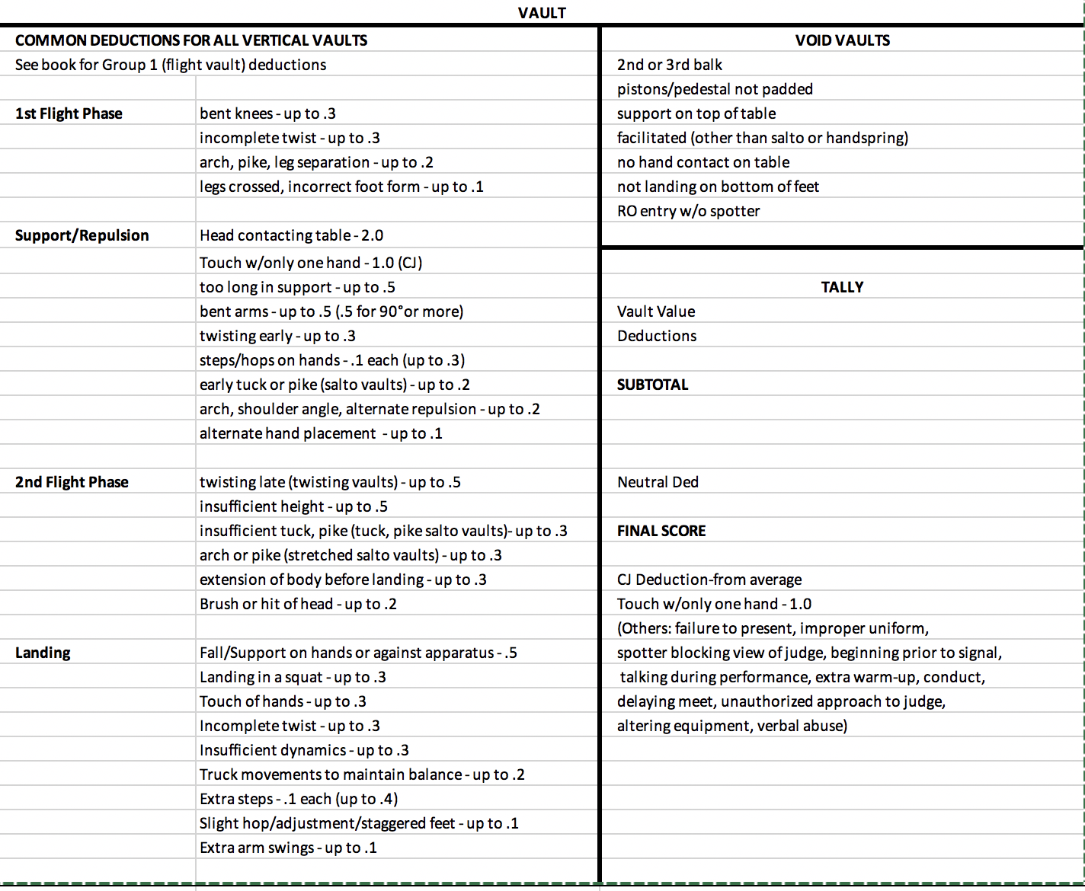

Slide 6
BARS, BEAM, FLOOR

Slide 7
Scoring for Bars, Beam, and Floor
Difficulty | 3.0
Composition | 1.0
Event Requirements | 1.0
Execution and Amplitude | 4.2
Bonus | 0.8

Slide 8
Difficulty (3.0)
A basic routine shall contain at least:
1 high superior or advanced high superior Value Part (0.3)……0.3
3 superior Value Parts (0.5 each)...............................................1.5
4 medium Value Parts (0.3 each)...............................................1.2
See each event for specific difficulty values.

Slide 9
Difficulty
When a gymnast is lacking the minimum number of elements of any value (M/S/HS), elements of a higher value shall be used to replace elements of a lesser value on a one for one basis. If any element(s) is still missing, deduct the actual value of the missing element(s).
NOTE: Calculate difficulty credit to the benefit of the gymnast. Elements of a higher value that are used to replace elements of a lower value, retain their original value.
When a gymnast uses an advanced high superior, rather than a high superior to fulfill difficulty, the advanced high superior may also be awarded 0.2 in Bonus provided it is performed without a fall or spot.

Slide 10
Awarding Difficulty
No Value Part is awarded:
Fall during execution of element (weight not borne)
  If the element is almost complete before the fall, Value Part credit is given, but the fall deduction is taken
Failure to land on any part of the bottom of the feet
Spotter facilitates the element
Element performed a third time
NOTE: Elements/series listed separately in the rules book are considered separate elements/series. Any element can be recognized as a Value Part two times. The third time an element is repeated it will not receive Value Part credit. If an element does not receive Value Part credit, it cannot be used to fulfill event requirements or Bonus.

Slide 11
Execution (Technique/Amplitude/Posture) (4.2)
Slight/Small Faults …………….………………………. 0.05-0.10
Medium Faults …………………….……………………Up to 0.20
Large Faults ………………………………..………….. Up to 0.30
Very Large Faults …………….……………………………… 0.50

Slide 12
Bonus (.8)
Up to .4 for advanced high superiors
  Provided there is no fall or spot
  .2 for one AHS or .4 if there is a second different AHS
Up to .2 for a high-level back-to-back superior
  HS + HS; AHS + AHS; HS + AHS
  For beam only: AHS acro + S acro
  For floor only: AHS acro + S salto
Up to .2 for any of the following:
  Low-level back-to-back superior (S + S, S + HS, S + AHS)
  2nd high-level back-to-back superior (same or different)
  3rd different AHS (with no fall or spot)

Slide 13
Bonus (.8), continued
On balance beam only:
An AHS acro element directly connected(before or after)to a S acro element will receive 0.20 as a HL BBS.
Back-to-back superior credit may be awarded if there is a fall following the second element in the series provided both elements are considered complete according to the criteria for awarding Value Part credit.
On floor exercise only:
a. S,HS and/or AHS acro elements that are indirectly connected within one continuous, uninterrupted acro pass may be given BBS credit. Example: front salto, round-off, flic-flac, back salto.
b. An AHS acro element directly connected (before or after) to a S salto will receive 0.20 as a HL BBS

Slide 14
EVENT REQUIREMENTS.................................... 1.0
Lack of event requirement (each one omitted...0.2
See each event for specific requirements. Elements not awarded Value Part credit may not be used to fulfill event requirements.
COMPOSITION ................................................. 1.0
See each event for specific deductions.
EXECUTION (Technique/Amplitude/Posture).......4.2
See each event for specific execution deductions.

Slide 15
UNEVEN BARS

Slide 16
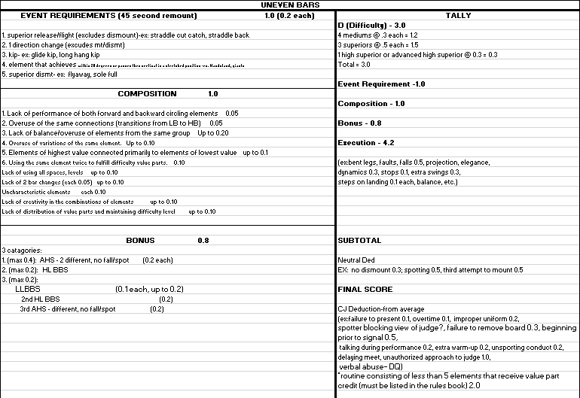

Slide 17
Event Requirements on Bars (1.0)
a. Superior release/flight element (excludes dismount) b. One direction change (excludes mount/dismount)
c. Kip d. Element that achieves (within 20 degrees) or passes through vertical in a stretched position e. Superior dismount

Slide 18
Composition (1.0)
Specific Compositional Deductions to be Considered:
1. Lack of performance of both forward and backward circling elements .........0.05
2. Overuse of the same connections (transitions from LB to HB........................0.05
3. Lack of balance/overuse of elements from the same group ................ Up to 0.20
Examples: circles / swings / kips / pirouettes / releases
4. Overuse of variations of the same element ……………..…..…………..… Up to 0.10
5. Elements of highest value connected primarily to those of lowest value…Up to 0.10
6. Using the same element twice to fulfill difficulty value parts………….……………....0.10
7. Lack of using all spaces, levels …………………………………….................. Up to 0.10
8. Lack of 2 bar changes..............................................................(each 0.05) Up to 0.10
NOTE: A fall from 1 bar and continuation on the other bar constitutes a bar change.
9. Uncharacteristic elements .......................................................................... each 0.10
10. Lack of creativity in the combinations of elements ................................. Up to 0.10
11. Lack of distribution of value parts and maintaining difficulty level throughout ….. Up to 0.10

Slide 19
BALANCE BEAM

Slide 20
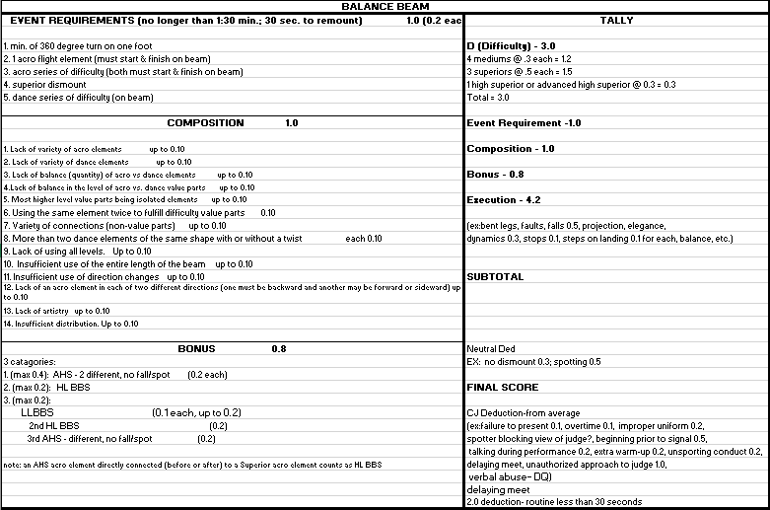

Slide 21
Event Requirements on Beam (1.0)
a. Minimum 360-degree turn on one foot;
b. One acro flight element (must start and finish on the beam);
c. Acro series of difficulty (both elements must start and finish on the beam);
d. Superior dismount;
e. Dance series of difficulty (on beam; does not include balances and body waves)

Slide 22
Composition on Beam (1.0)
All are up to .1, unless otherwise noted:
Lack of variety of acro elements
Lack of variety of dance elements
Lack of balance (quantity) of acro vs. dance
Lack of balance in the level of acro vs. dance value parts
Most higher level value parts being isolated elements
Using the same element twice to fulfill difficulty (.1)
Variety of connections
  non-value parts, arm movements, locomotor movements
  more than 2 straight leg pivot turns
More than two dance elements of the same shape with or without a twist (.1)
Lack of using all levels
  Movements that are high off the beam, semi-low, and low (kneel, squat, sit, lying)
Insufficient use of the entire length of the beam
Insufficient use of direction changes
  Movements/non-value parts/choreography, forward, backward, & sideward
  Continued on next page

Slide 23
Composition on Beam, cont.
All are up to .1, unless otherwise noted:
Lack of an acro element in each of two different directions (one must be backward and another may be forward or sideward)
  Must have one of each that both start and finish on the beam for no deduction. EXCEPTION: The mount may be used.
  If either or both is missing – deduct 0.10
  If both are included but one is the dismount – deduct 0.05
  A tic-toc may count as a forward or backward direction element.
  May not include a handstand which has no direction
Lack of artistry
  Quality of gymnast’s movement to reflect her personal style, Quality of expression (projection, emotion, focus), Originality
Insufficient distribution
  Level of difficulty not maintained throughout the exercise
  Most difficult elements placed in same section of exercise

Slide 24
Timing on Beam
The duration of the exercise shall be no longer than 1:30. There is a deduction if the routine is less than 30 seconds.
The timing and evaluation shall begin at the moment the gymnast’s hands or feet leave the floor or board and conclude when the gymnast arrives on the floor at the completion of her dismount.
If the gymnast falls from the beam, the routine watch is stopped. Following a fall, the timing of the routine resumes with the first movement to continue the routine.
A warning signal shall be given at 1:20 and time at 1:30
If the gymnast is on the beam or in the air at the final time signal, the judges continue to evaluate the routine.
The gymnast is allowed 30 seconds to remount the beam after a fall.

Slide 25
FLOOR EXERCISE

Slide 26
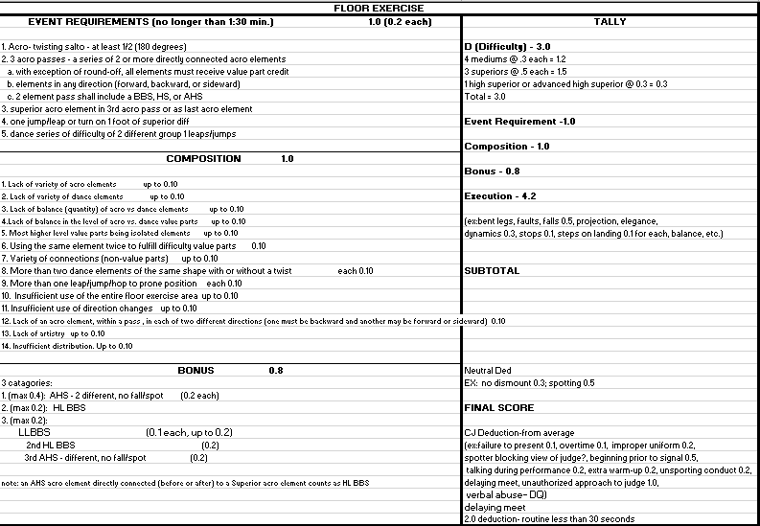

Slide 27
Timing on Floor
The duration of the routine shall not exceed 1 minute, 30 seconds.
The clock shall start as soon as the gymnast begins a movement of the exercise and shall stop when she when she maintains her final position.

Slide 28
Event Requirements on Floor
All of the following event requirements are required in the routine. A single element may fulfill more than one event requirement (exception: A single element within a series shall not be used twice in order to fulfill two series requirements).

Slide 29
Event Requirements on Floor a. Acro
1. Twisting salto - at least 1⁄2 (180 degrees);
2. Three acro passes – a series consisting of two or more directly connected acro elements: a. With the exception of the round-off, all elements in a pass must receive Value Part credit; b. Elements may be in any of the three directions: forward, backward or sideward;
NOTE: A handstand with or without a turn has no direction unless it is completed as a front walkover or a handstand forward roll. c. A two element pass shall include a back-to-back superior, a high superior or an advanced high superior.
3. Superior acro element in the third acro pass or as last acro element; a. Credit may be awarded even if the first and/or second pass is broken b. A series of front or back handsprings, which receives superior credit can be considered the last acro element. b. Dance
1. One jump/leap or turn on one foot of at least superior difficulty;
2. Dance series of difficulty of two different Group 1 leaps/jumps.

Slide 30
Composition on Floor (1.0)
All are up to .1, unless otherwise noted:
Lack of variety of acro elements
Lack of variety of dance elements
Lack of balance (quantity) of acro vs. dance
Lack of balance in the level of acro vs. dance value parts
Most higher level value parts being isolated elements
Using the same element twice to fulfill difficulty (.1)
Variety of connections
  non-value parts, arm movements, locomotor movements
More than two dance elements of the same shape with or without a twist (.1)
Continued on next slide

Slide 31
Composition on Floor, cont.
All are up to .1, unless otherwise noted:
More than one leap/hop/jump to prone position
Insufficient use of the entire floor area
Insufficient use of direction change
  Movements/non-value parts/choreography, forward, backward, & sideward
Lack of an acro element, within a pass, in each of two different directions (one must be backward and another may be forward or sideward)
  The two directions do not need to be in the same pass.
  Any acro element may be used to fulfill the two direction requirement except a
  roundoff and a handstand.
Lack of artistry
  Quality of gymnast’s movement to reflect her personal style, Quality of expression (projection, emotion, focus), Originality
Insufficient distribution
  Level of difficulty not maintained throughout the exercise
  Most difficult elements placed in same section of exercise

Slide 32
Inquiries
A coach may address the meet referee only by submitting in writing, an inquiry(ies) concerning his/her gymnast(s). The written inquiry or the verbal intent to inquire shall be submitted to the meet referee no later than five minutes after all scores for that team are recorded for that individual event.
The inquiry(ies) shall only concern:
Difficulty/vault value
Event requirements
Bonus
Neutral deductions
A mathematical error
NOTES:
No other judgment decisions shall be questioned.
A gymnast’s recorded scores may be checked by a coach at the scorer’s table without a deduction. After being recorded at the scorer’s table, the judges’ event summary scoresheets may be checked by the coach without deduction.
See: Score Inquiry Form on page 114 in Rule Book

Slide 33
Chief Judge Deductions
Flagrant exceeding of warm-up time or warming up in the competitive area (after one warning) From event score – or team score if team exceeds time Only applies to practice of element If preparing for element or dismount when time is called, gymnast may complete element or dismount without penalty | 0.2
Making an unauthorized approach of a judge concerning a score or rules infraction | 1.0
Questioning or attempting to influence judges’ decisions | 1.0
Unsporting conduct of gymnast (after one warning) | 0.2
Gymnast failing to begin exercise within 30 seconds after chief judge signals to begin | 0.8
Verbally abusing or disrespectfully addressing a judge/meet official or using profanity DQ from event and all-around. May lead to DQ from meet by meet ref | DQ

Slide 34
Session 2: Rule Changes, Rule Interpretations, and Frequently Asked Questions

Slide 35
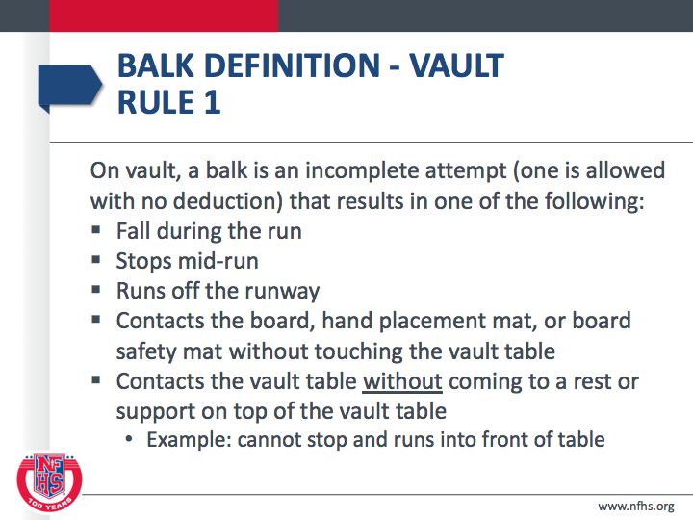

Slide 36
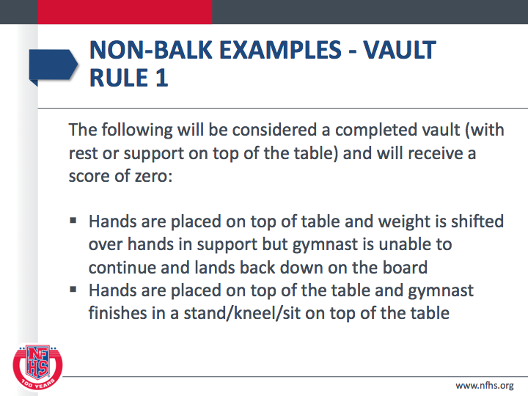

Slide 37
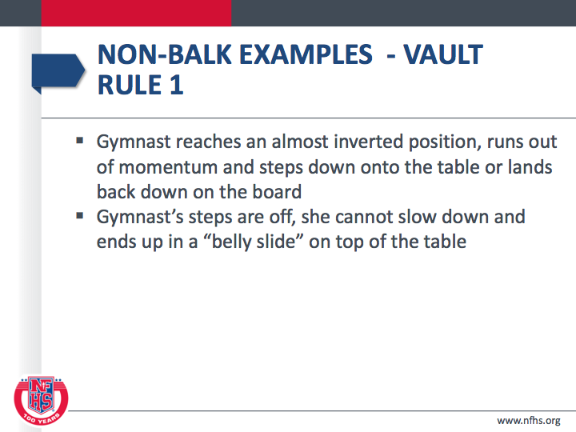

Slide 38
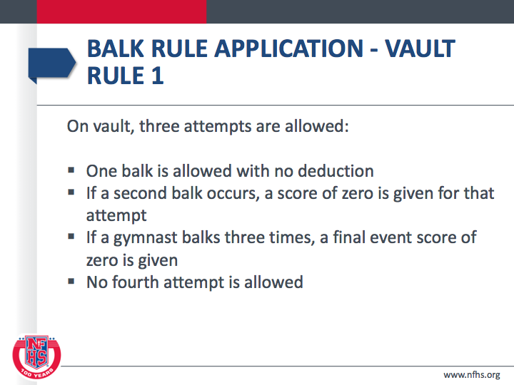

Slide 39
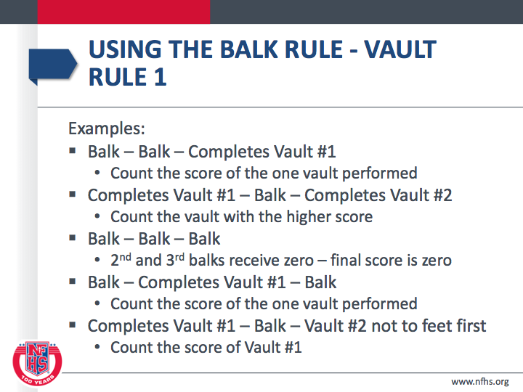

Slide 40
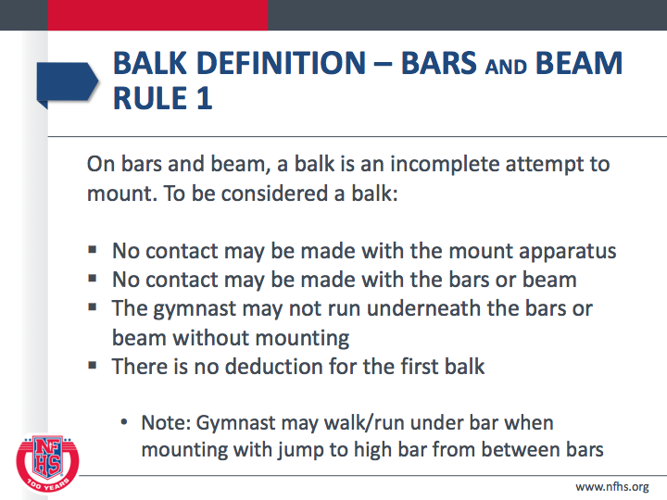

Slide 41
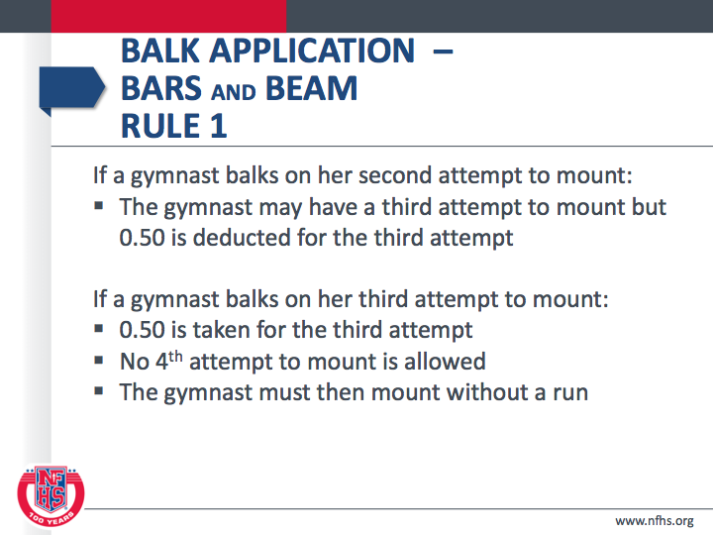

Slide 42
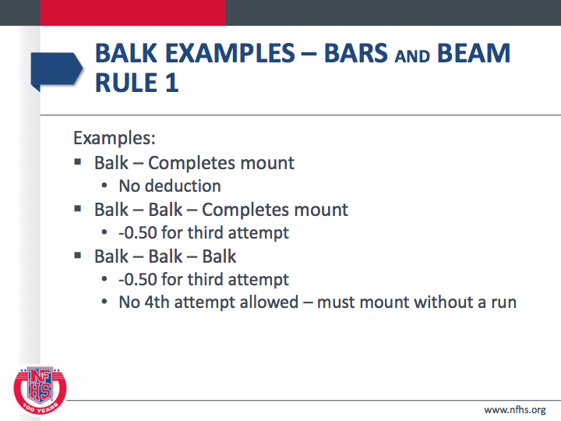

Slide 43
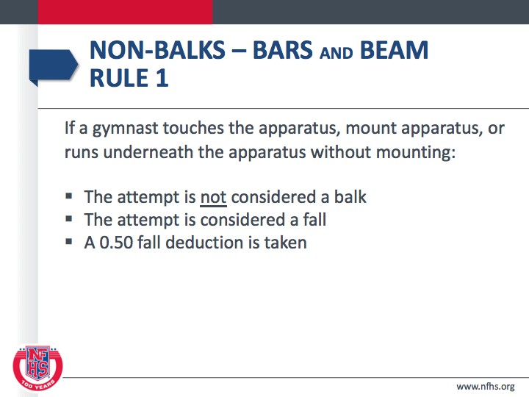

Slide 44
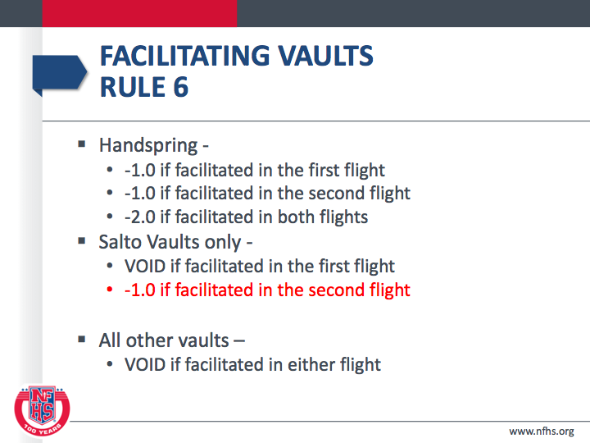

Slide 45
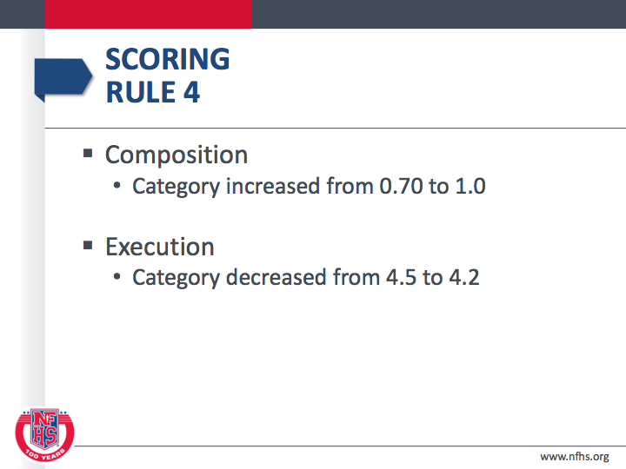

Slide 46
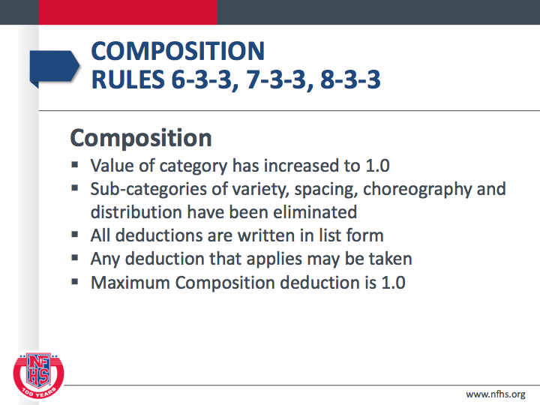

Slide 47
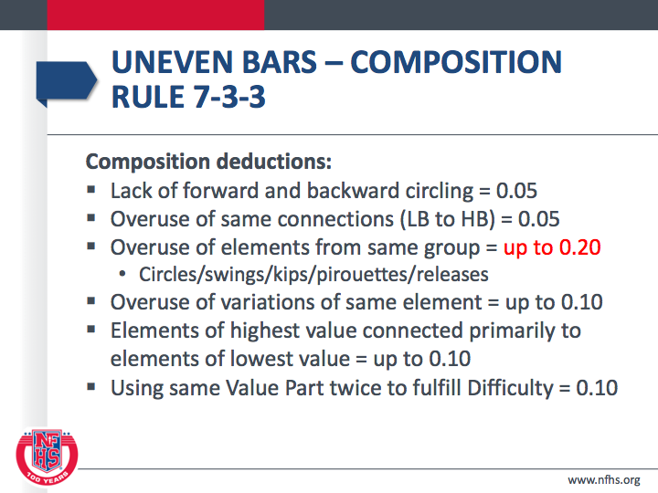

Slide 48
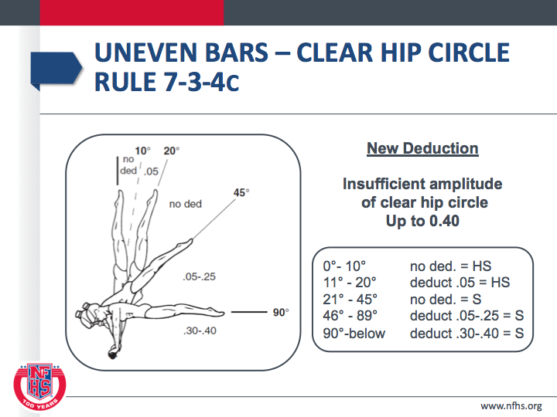

Slide 49
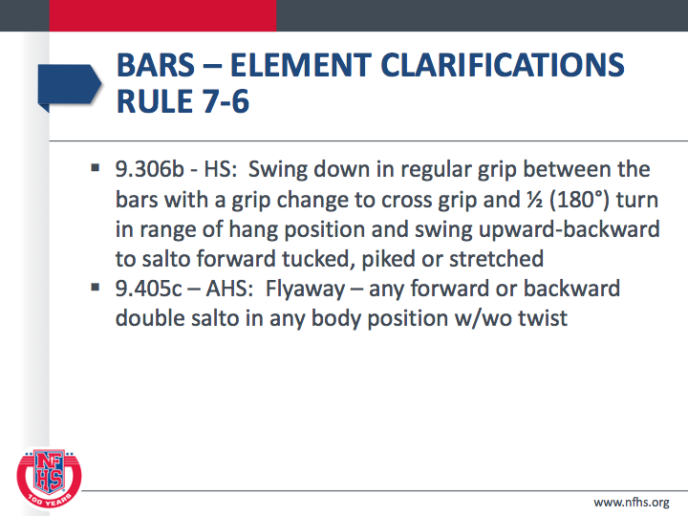

Slide 50
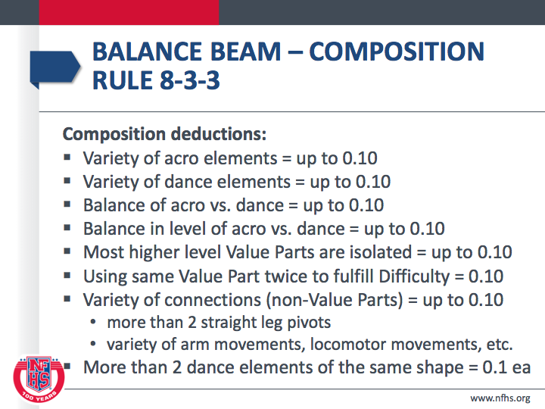

Slide 51
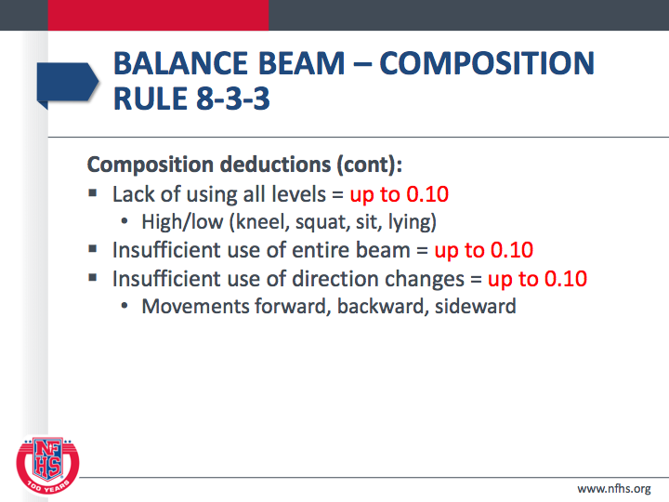

Slide 52
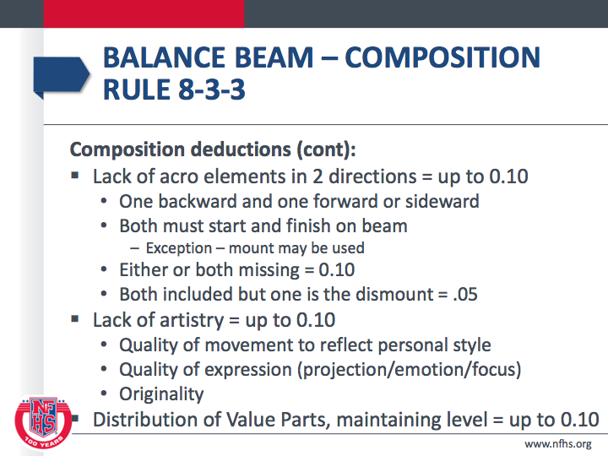

Slide 53
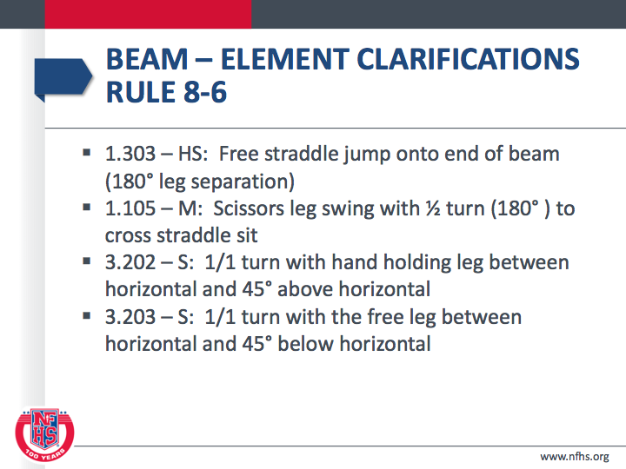

Slide 54
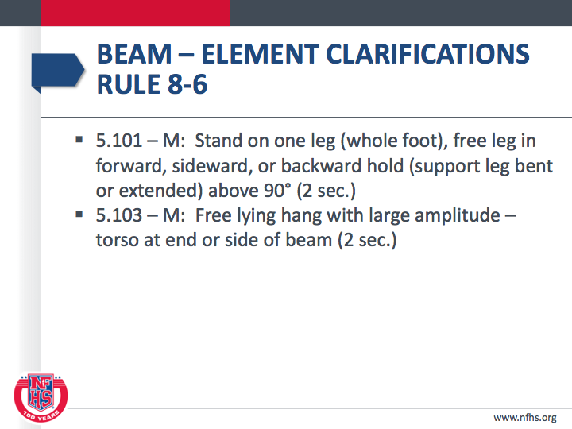

Slide 55
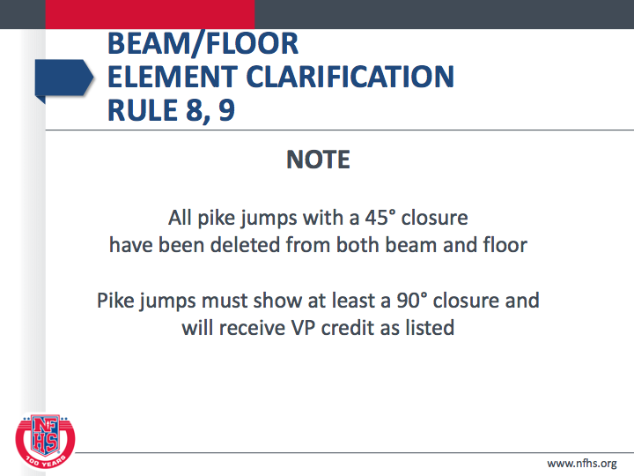

Slide 56
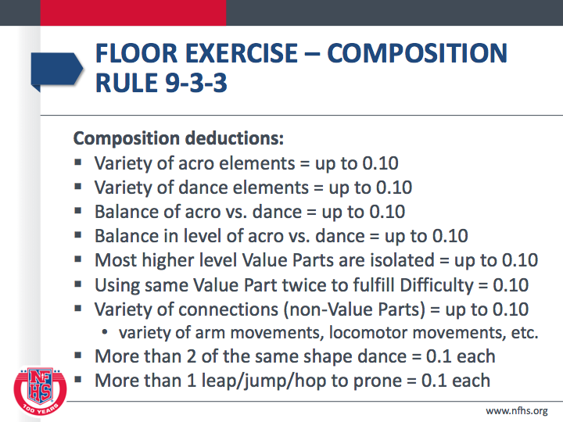

Slide 57
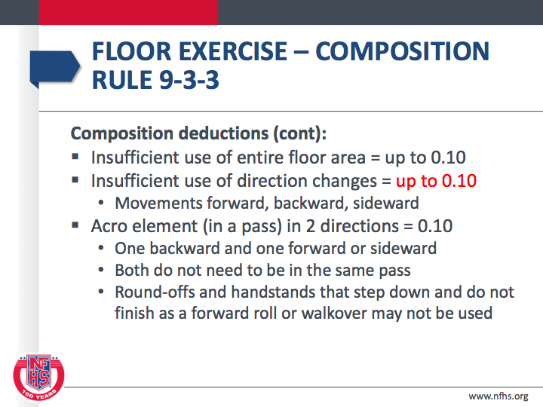

Slide 58
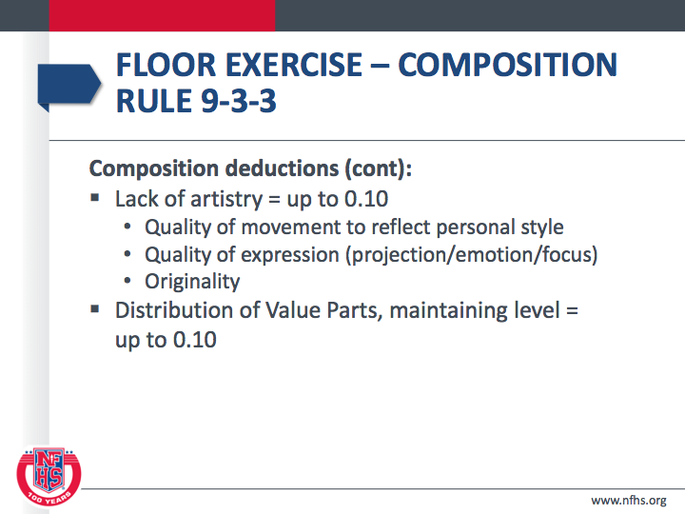

Slide 59
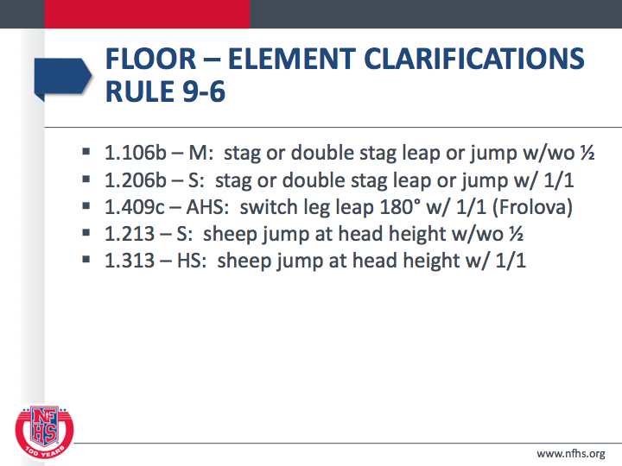

Slide 60
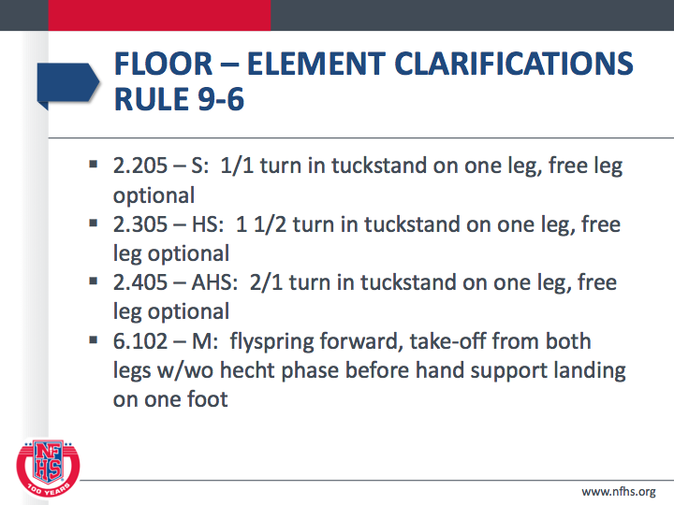

Slide 61
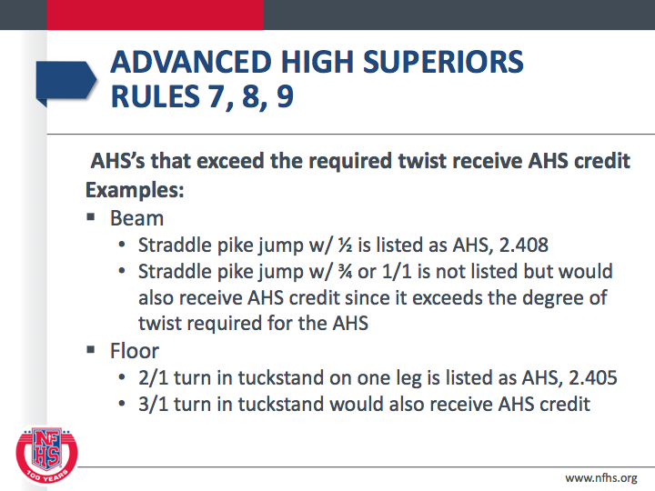

Slide 62
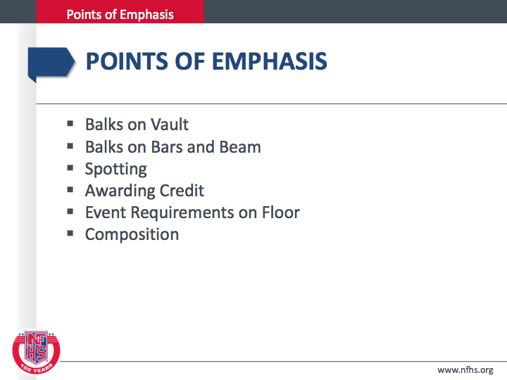

Slide 63
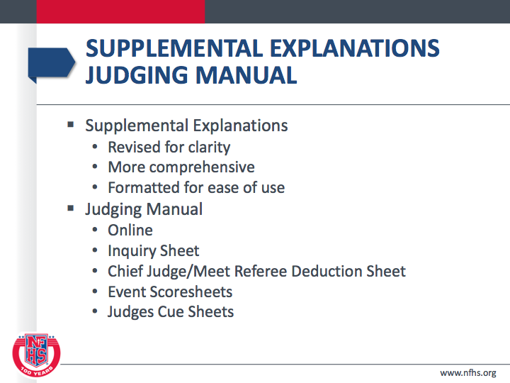

Slide 64
Session 3: Resources

Slide 65
NFHS | https://www.nfhs.org/activities-sports/gymnastics-girls/
Rule Interpretations | https://www.nfhs.org/sports-resource-content/girls-gymnastics-rules-interpretations-2018-19/
Frequently Asked Questions | https://www.nfhs.org/sports-resource-content/2018-2020-frequently-asked-questions/
GHSGGJA | http://gagymjudges.wixsite.com/ga-gymnastics-judges
GHSA Penny Pitts | https://www.ghsa.net/gymnastics

Slide 66


Slide 67
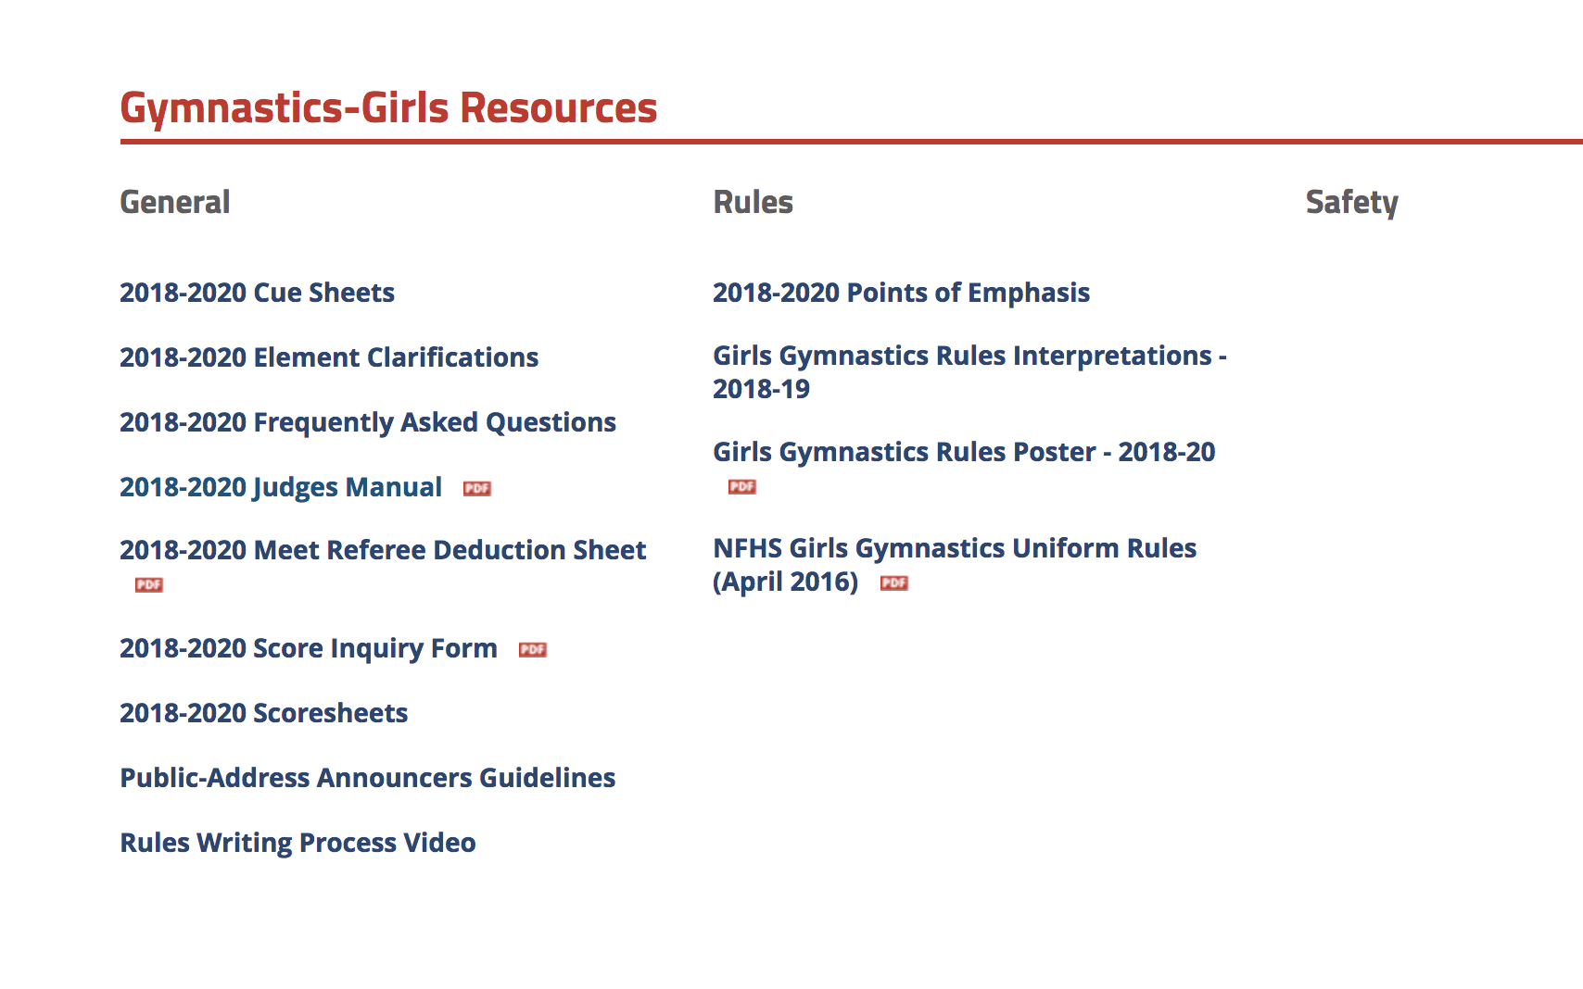

Slide 68
GHSGGJA http://gagymjudges.wixsite.com/ga-gymnastics-judges

Slide 69
Contacts
Gymnastics Coordinator, Dr. Lucia B. Norwood luebella@bellsouth.net
GHSA Gymnastics Director, Penny Pitts Mitchell pennypitts@ghsa.net
GHSGGJA (Judges Association) President, Margaret Stephens margaret.stephens@westrock.com
GHSGGJA Vice-President & Treasurer/NFHS Rules Committee, Amy Eubanks amye@westminster.net
GHSGGJA Booking Agent, Tripp Norris frtripp@saintcolumba.net

Slide 70
Session 4: 4:00- 4:30
Coaches - Meet management
New Judges - Expectations, requirements, etc.

